Slide 1
Lecture 14: Course Summary
Gregory Gay and Sam Jobara
TDA/DIT 594 - December 17, 2020

Slide 2
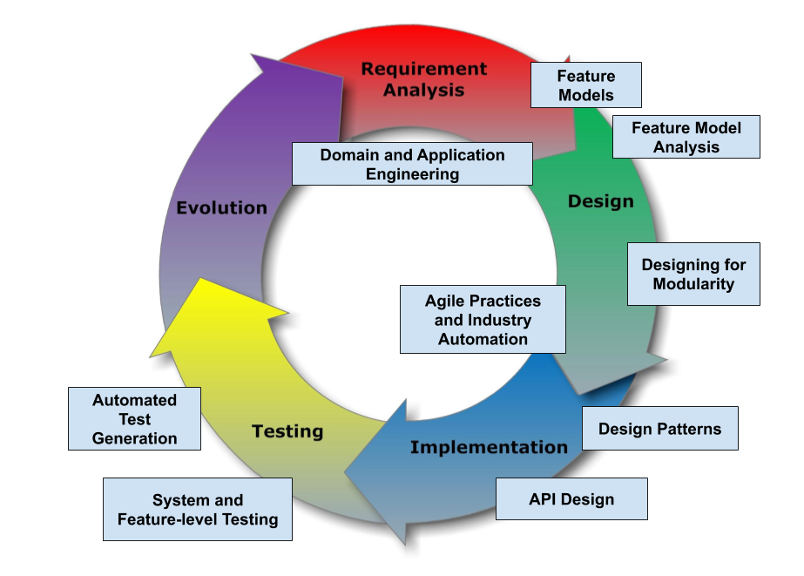
TDA/DIT 594 - SE Principles for Complex Systems
Notes:
Today is our last lecture, and today, we’re going to use the class to recap what we have covered. The goal of this course wasto present advanced techniques aimed at creating complex systems with many interacting features and variable configurations. We examined the design, implementation, and verification of complex systems, focusing on managing complexity at different stages of the system development life cycle. We will also examine how the development process must be organized to deliver such systems. (go over core topics). Mainly, today, we will be summarizing the material we covered, presenting some of the highlights. This is a great chance to ask questions and get clarification. We will be watching the chat as we present, and will be happy to spend a few minutes handling anything that is still confusing that we glossed over before.

Slide 3
Individual Assignment - Jan 13
Take home exam.
Mix of multiple choice, essay, open-ended questions.
Will be made available on Canvas at 9:00 on January 13th and due at 19:00.
Based on topics covered in lectures, more theory-based than group assignments.
Notes:
Of course, this somewhat leads into the individual assignment, which we have talked about here and there. (go over) More in the announcement on Canvas.

Slide 4
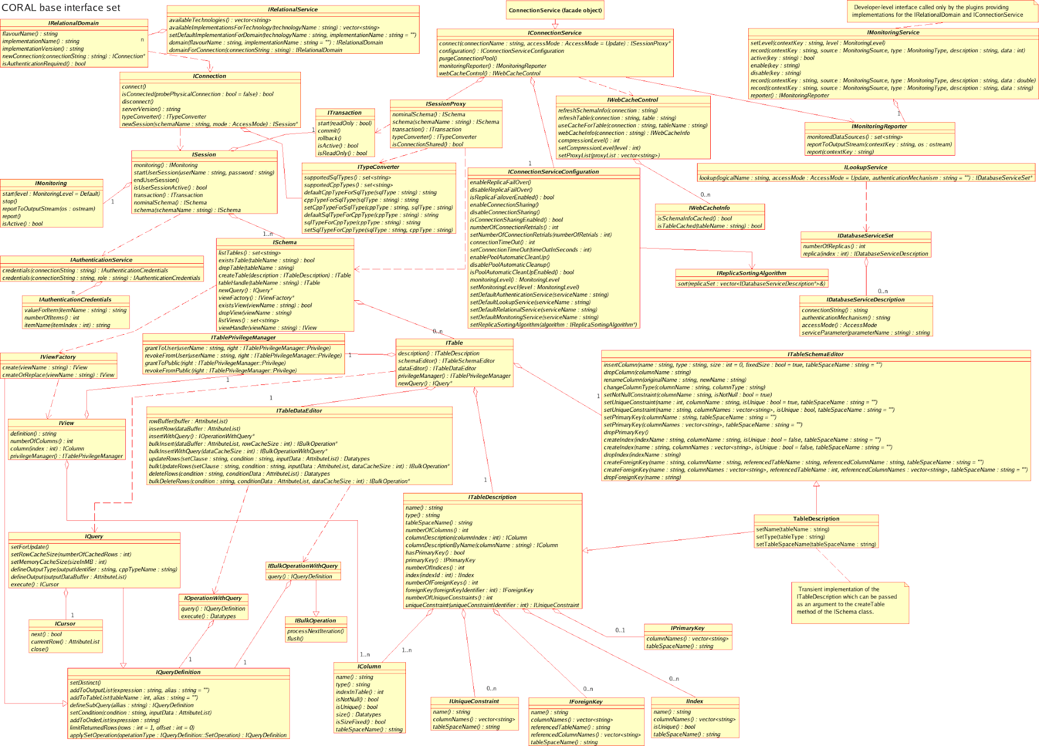
Under the Hood
Systems have millions of lines of code.
In hundreds of classes.
We want to reuse code.
On different hardware.
In many different apps.
We want the systems to live for years.
Notes:
Let’s launch into it. Over time, The scope of software has expanded. Our society depends on complex software, with software expanding how we automate factories, move transportation, conduct business, and regulate our bodies. All of these domains boast software systems of unprecedented complexity, many of which are long-living and exist in many different variants. However, growth in scope means growth in the size and complexity of the code base. (1-2). If not more. Keeps growing. (3) and extend that code, we want to run it on many different hardware platforms and in many different apps, or different version of the same app, with only minor adaptations. We want these systems to last for years to come.

Slide 5
Complex???????????
Variability
The ability to change and customize software to deliver variants to new users.
Requires designing code to be reused and to work with reused code.
Changeability and Maintainability
The ability to add new features and options while ensuring that existing code still works.
Notes:
Now, what the $#%#^#$ does complex mean? “complex” can describe about anything. Almost any piece of software you will build, ever, in a professional setting is going to be complex. Anything you build in a team. Anything that is sold commercially. Arguably, every single class you’ve taken here has been prep for building complex systemn. So, we need to focus in this class in some way. Our focus is, then, on variability and evolution. Variability is the ability to change and customize software, to choose from a set of options to configure and evolve software to the needs of new groups of users users over time, delivering these customized variants to the users that need them. Variability is not a one and done design choice - it is a concious process of designing for evolution. It requires designing and redesigning systems to be reused and to work with the code you are reusing. It requires a constant focus on changeability and maintainability. Our ability to add new options and features to code over time, and our ability to keep the existing code still working in the face of constant change. In this class, that is what we define complex to mean and what we focus on.

Slide 6





Software Product Lines
Highly configurable families of systems.
Built around common, modularized features.
Common set of core assets.
Allows efficient development, customization.
Examples:
Notes:
Much of this course has focused on software product lines (SPLs) - highly configurable families of systems built around common, modularized features. Together, SPLs address the needs of a particular market segment or mission. They are developed from a common set of core assets in a planned way. By developing large software systems in this way, companies can produce a set of products more economically, since the development effort put into the shared assets does not need to be duplicated. SPLs can also help companies to better address product customization tasks to meet specific needs of individual customers. This allows sustaining a high rate of product innovation, while keeping guaranteed levels of overall system performance and quality. SPLs are seen in many domains, and are highly challenging to develop as they have technical, process, organization, and business-related aspects.

Slide 7
Software Product Lines
Build variants from reusable shared assets.
Customers select from configuration options.
Assets = code components, interfaces, other resources.
Enables customization, while retaining benefits of mass production.
Avoids explosion in “space” as we manage the portfolio of assets instead of each individual variant.
Notes:
The central idea of software product lines is that instead of developing software systems from scratch, they should be constructed from reusable parts. Instead of composing a software system always in the same way, it should be tailored to requirements of the customer, where customers can select from a large space of configuration options. The software product line approach provides a form of mass customization by constructing individual solutions based on a portfolio of reusable software components - those shared assets I keep mentioning - where an asset can be code components, APIs, UI elements, images, and other resources. It introduces individualism into software production, but still retains the benefits of mass production in that huge domain and market segments can be served. It also avoids the exponential explosion in time and space, as we don’t manage entire clones, but rather the one portfolio of assets and variation points.

Slide 8
Feature-Oriented Approach
Features distinguish products from a product line.
Editor Version A has spell-check. Version B does not.
E-mail client A supports IMAP and POP3. Client B supports only POP3.
Product line artifacts and process structured around features and feature interactions.
Discuss control, implementation, verification of features.
Connects requirements to customizations in code.
Notes:
Ideally, based on a set of reusable parts, a software manufacturer can generate a software product based on the requirements of a certain customer. The concept of a feature is central to achieve this level of automation. Features are used to distinguish the products of a product line, for example: one text editor provides a spell-checking feature, while another version does not. Database system variant A provides multi-user support, variant B does not. E-mail client A supports IMAP and POP3, client B supports only POP3.” and so on. As a result, we tendto organize and structure the whole product-line process as well as all software artifacts involved in terms of features, and reason abotu variability by discussing how we control, implement, and verify the interactions between features. This way, it is easy to trace the requirements of a customer to the software artifacts that provide the corresponding functionality. We features explicit in requirements, design, code, testing, and so forth—across the entire life cycle.

Slide 9
Domain Engineering and Feature Modelling
Notes:
Just start with a question - want you to start thinking about this. (read)
This isn’t something with one answer, or even a right answer. It’s something we’ll keep returning to

Slide 10
Learning Objectives
Define feature, feature selection, feature dependency, product, domain.
Understand what drives scoping decisions
Translate feature diagrams to propositional formulas
Modal features and feature dependencies by means of feature models
Identify some industrial automation tools for Feature Modelling
Main Reference:
Feature-Oriented Software Product Lines: Concepts and Implementation,
Sven Apel • Don Batory •Christian Kästner • Gunter Saake
Springer-Verlag Berlin Heidelberg 2013, ISBN 978-3-642-37521-7
Other publications (see slides for references)

Slide 11
SPL Domain
A key success factor of product-line development is to set a proper focus on a
particular, well-defined and well-scoped domain.
A domain is an area of knowledge that:
is scoped to maximize the satisfaction of the requirements of its stakeholders,
includes a set of concepts and terminology understood by practitioners in that area and includes the knowledge of how to build software systems.

Slide 12
Domain Engineering
Domain engineering is the process of analyzing the domain of a product line and developing reusable artifacts. Domain engineering does not result in a specific software product, but prepares artifacts to be used in multiple, if not all, products of a product line.
Domain engineering is the life-cycle that is further responsible for scoping the product line and ensuring that the platform has the variability that is needed to support the desired scope of products. It targets development for reuse.
Domain engineering results in the common assets that together constitute the product line’s platform.

Slide 13
Domain Modelling
Domain modelling captures and documents the commonalities and variabilities of the scoped domain.
Typically, commonalities and differences between desired products are identified and documented in terms of features and their mutual dependencies under feature models.
Example: Supply Chain Management

Slide 14
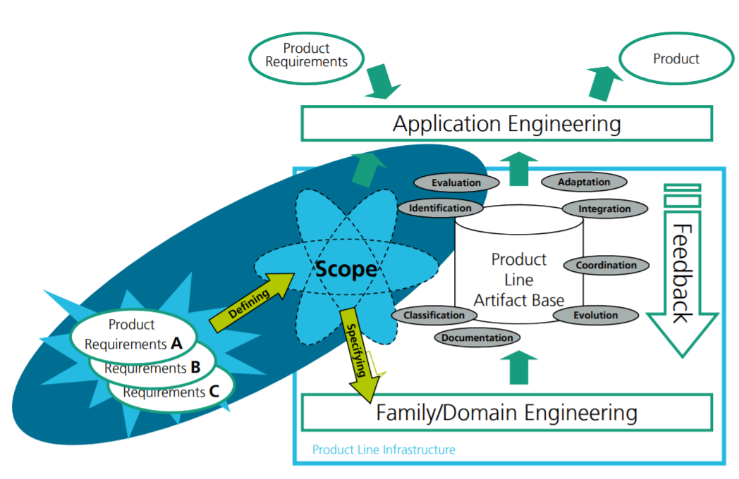
Domain Modelling Domain Analysis: Scoping
Domain scoping is the process of deciding on a product line’s extent or range.
The scope describes desired features or specific products that should be supported.
Features Artifacts
Artifacts Products
http://wwwagse.informatik.uni-kl.de/teaching/ple/ws2011/PLE11_03_Scoping.pdf

Slide 15
Domain Analysis: Scoping Common scoping approaches
Products:
Which products do I want in my product line? What is their market, when will they be released?
Domains:
Which subdomains will my product line have? Which information do they carry? What are reasonable domains for the product line (in terms of knowledge, stability etc)?
Features:
Which features will my product line have? Which product will have what kind of features? Which are easy, which are risky features?
Assets:
Which assets do I have in my product line? Which components, documentation etc exists already in a reusable form, which ones do I have to (re-)implement?

Slide 16
What is a Feature?
Concept in a domain
Can be seen as a high-level requirement
Features represent commonalities and variabilities in a product line
Unit of communication among stakeholders
A specific set of features determines a product variant
feature configuration as input to product derivation
A feature is a kind of concern
concerns
features

Slide 17
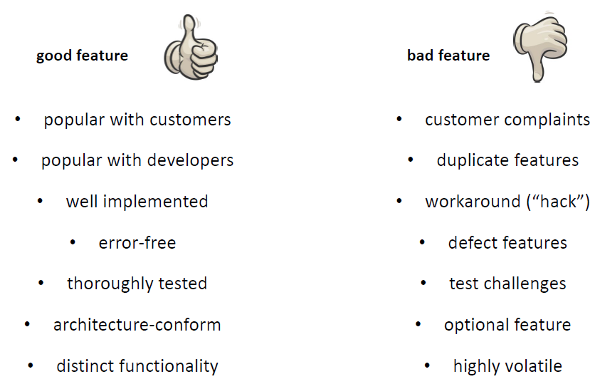
What is a Feature?
Feature-Based Configuration involves:
Checking for satisfiability of FMs
Enforcing correct configurations
Counting possible configurations
Enumerating valid configurations
Propagating configuration decisions
Merging distributed configurations
…

Slide 18
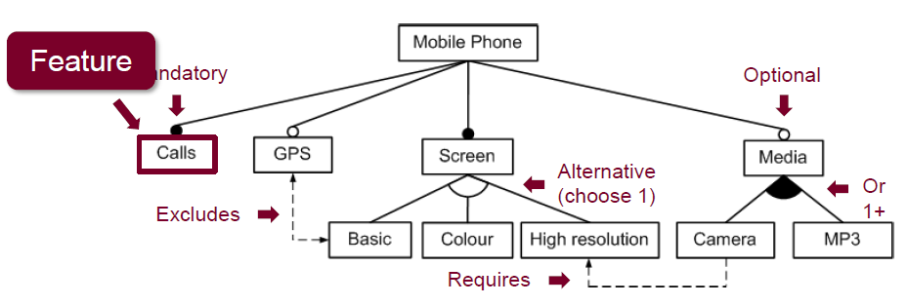
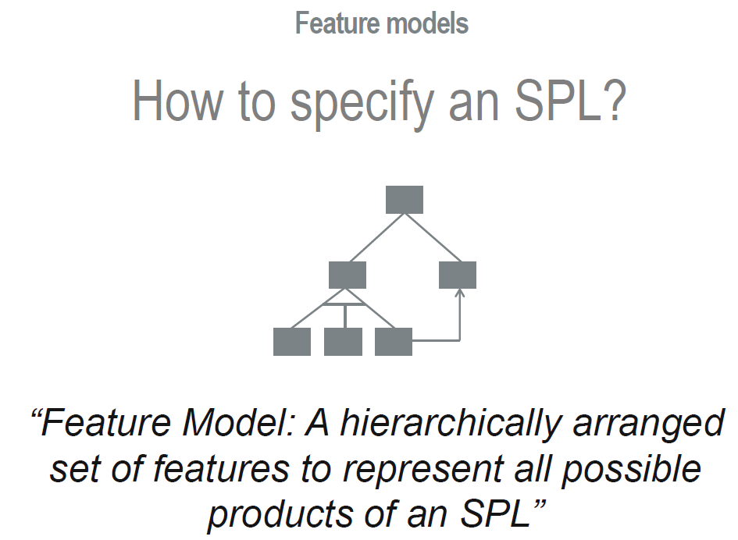
Feature Modelling

Slide 19
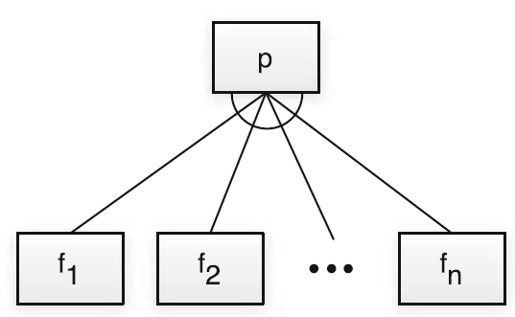
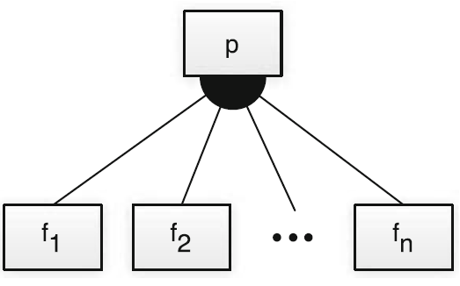
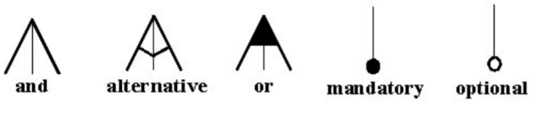
Feature Modelling Feature Diagrams
A feature diagram is a graphical notation to specify a feature model. It is a tree
whose nodes are labeled with feature names. Different notations convey various
parent–child relationships between features and their constraints:
Only One-out-of many choice. This choice
corresponds to a generalized XOR operator
Some-out-of-many choice. This choice corresponds to the logical OR operator

Slide 20
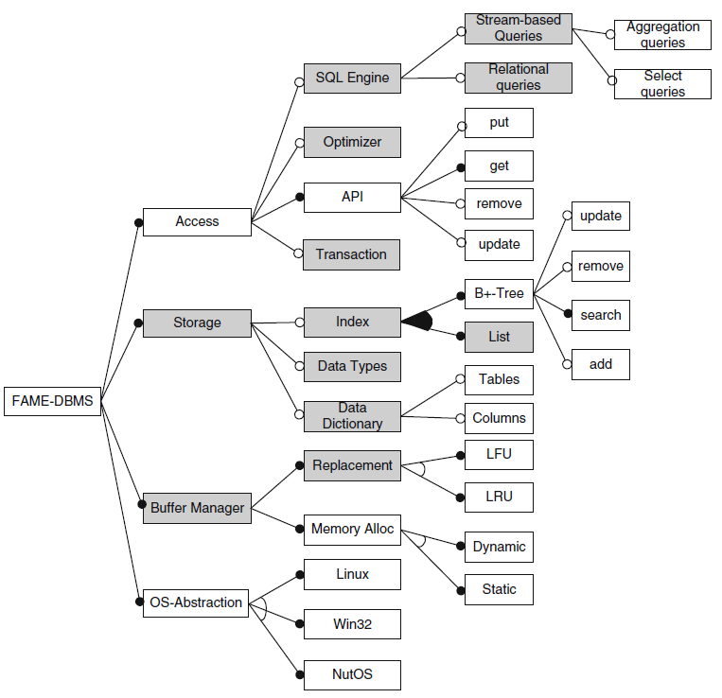
Feature Modelling Feature Diagrams
Figure 2.5 shows an example of a feature
diagram that, in its complete form, covers
65 features. Nodes shaded in gray are
folded subtrees.
Fig. 2.5 Sample feature diagram for embedded data management

Slide 21
Feature Modelling Formalization in Propositional Logic
Feature diagrams can be directly mapped to propositional formulas, thereby defining a formal semantics of feature diagrams. A set F of feature names are interpreted as propositional variables, and p, f and fi are members of F.
A mandatory feature definition between a parent feature p and a child feature f:
mandatory(p,f) ≡ f ⇔ p
Denote solid bullet, if the parent feature is selected, then the child must be selected, and vice versa
An optional feature states that the parent p may be chosen independently from f, but the child f can only be chosen if p is selected:
optional(p,f) ≡ f ⇒ p
Denoted by an empty bullet

Slide 22
Feature Modelling Formalization in Propositional Logic
Mapped to propositional logic, this is a disjunction, in which, at least, one child feature is selected when the parent is chosen. It is an XOR, one-out-of-many choice:
An unrestricted choice denoted by a filled arc in feature diagrams. Mapped to propositional logic, the selection of p is equivalent to a disjunction of the child features. It is an OR, some-out-of-many choice:
Propositional logic enables us to use automated tools to test interesting properties, such as checking validity of feature models and feature selections, and detect dead features

Slide 23
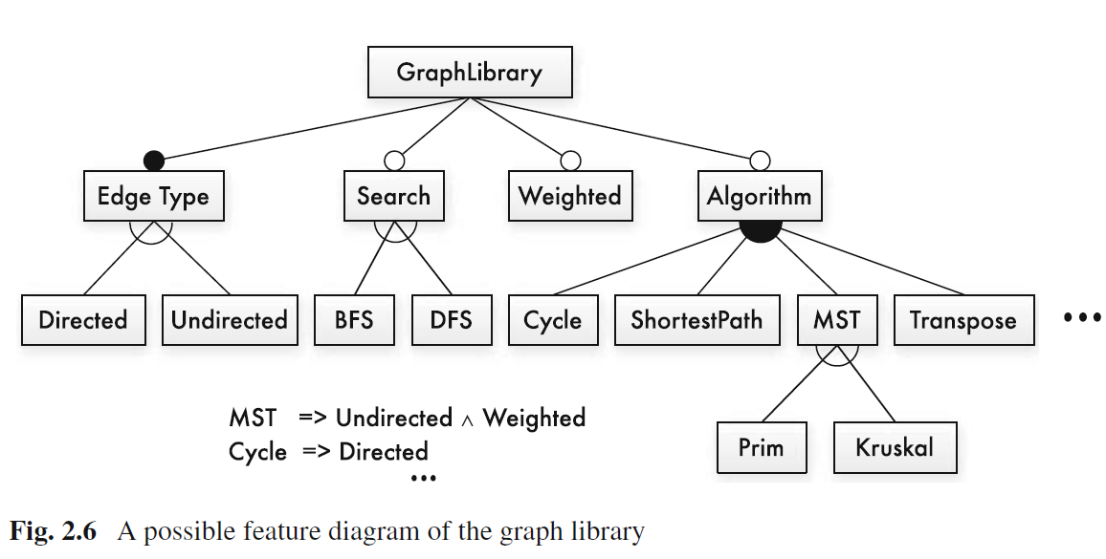
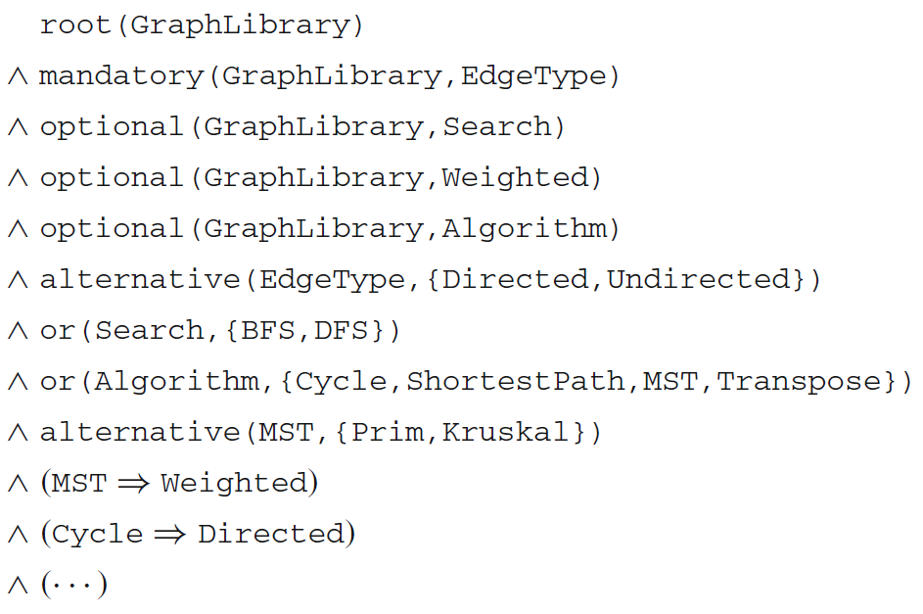
Feature Modelling Formalization in Propositional Logic
We use the product line of graph libraries to illustrate feature diagrams formalization. We use the feature diagram to illustrate the mapping to a propositional formulas:
Any coment over the formula of Search node?
∧ alternative(Search,{DFS,BFS})

Slide 24
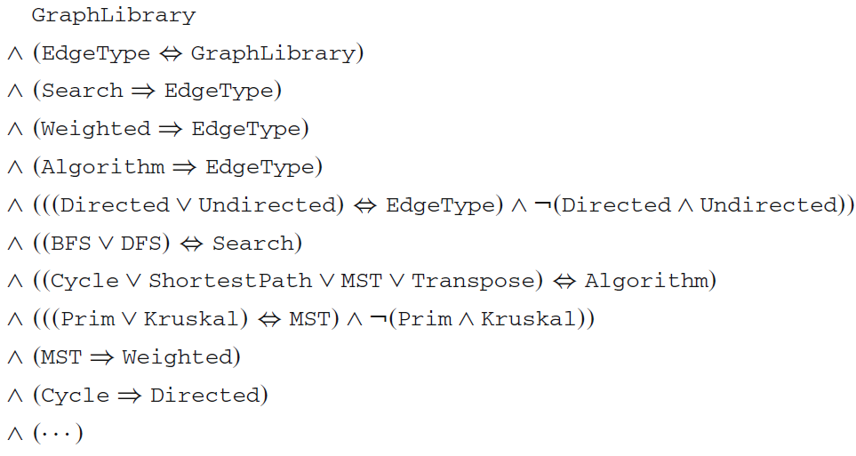
Feature Modelling Formalization in Propositional Logic
After expanding the feature constraints, we arrive at the following formula:
∧ (((BFS ∨ DFS) ⇔ Search) ∧ ￢(BFS ∧ DFS))

Slide 25
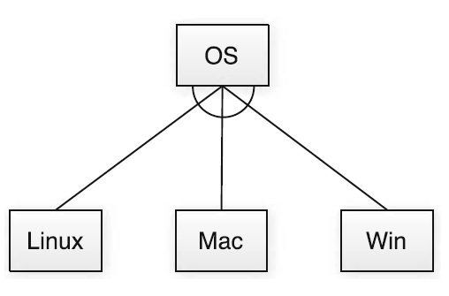
Feature Modelling Formalization in Propositional Logic
To illustrate the transformation to propositional logic for 3-children situations, we use an additional example to ensure all combinations are counted for:
OS ⇔ (Linux ∨ Win ∨ Mac)∧￢(Linux ∧ Win)∧￢(Linux ∧ Mac)∧￢(Win ∧ Mac)

Slide 26
Feature-Modelling Principles*
Feature models help developers to keep an overall understanding of the system, and also support scoping, planning, development, variant derivation, configuration, testing, and maintenance activities that sustain the system’s long-term success.
In this research* a set of 34 principles, covering eight different phases of feature modeling, these principles provide practical, context specific advice on how to perform feature modeling, describe what information sources to consider, and highlight common characteristics of feature models.
These principles should enhance feature-modeling tooling, synthesis, and analyses techniques.
*http://www.cse.chalmers.se/~bergert/paper/2019-fse-fm_principles.pdf
“Principles of Feature Modeling” Damir Nešić, Jacob Krüger, Ştefan Stănciulescu, Thorsten Berger

Slide 27
Feature-modeling principles 2. Model Organization
MO1: The depth of the feature-model hierarchy should not exceed eight levels. While rarely made explicit in experience reports, survey papers and most of our interviewees report that the feature-model hierarchy is typically between three to six levels deep
MO2: Features at higher levels in the hierarchy should be more abstract. We found that the higher a feature is in the feature-model hierarchy, the more it is visible to the customers or it represents a more abstract domain-specific functionality.
MO3: Split large models Several sources state that large feature models with thousands of features should be decomposed into smaller ones.

Slide 28
Feature-modeling principles 2. Model Organization
MO4: Avoid complex cross-tree constraints. Cross-tree constraints allow adding dependencies between subtree of a feature model. However, complex constraints, typically in the form of arbitrary Boolean formulas, hamper comprehension, maintenance, and evolution of model.
MO5: Maximize cohesion and minimize coupling with feature groups. A high cohesion within a group and low coupling to other groups (absence of cross-tree constraints) indicates that the features belong together, which will also promote higher reusability.

Slide 29
Feature-modeling principles 3. Modeling
M1: Use workshops to extract domain knowledge. Workshops are used extensively to initiate feature modeling; they are the most efficient way to start.
M2: Focus first on identifying features that distinguish variants. it is easier for most stakeholders to describe the features that distinguish variants from each other rather than focusing on the commonalities
M3: Apply bottom-up modeling to identify differences between artifacts. Different artifacts can be analyzed to identify the differences between existing variants. Source code files are typically the first artifacts to be analyzed, and the analysis can be done automatically by different tools.

Slide 30
Feature-modeling principles 3. Modeling
M4: Apply top-down modeling to identify differences in the domain. For a top-down analysis, “Top-down is successful with domain experts, more abstract features.” The features that emerge from the top down analysis typically represent commonalities or abstract features that help with feature model structuring
M5: Use a combination of bottom-up and top-down modeling. Due to the different results that can emerge from bottom-up and top-down analyses (M2), it is highly recommended to combine both strategies.
M6: A feature typically represents a distinctive, functional abstraction. While some works use feature models to represent non-functional properties (e.g., performance requirements or physical properties, such as color, majority emphasize that features should represent functional abstractions .

Slide 31
Model and Code Analysis
Notes:
Just start with a question - want you to start thinking about this. (read)
This isn’t something with one answer, or even a right answer. It’s something we’ll keep returning to

Slide 32
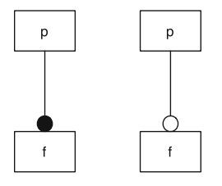
Propositional Logic
Mandatory: If parent is selected, the child must be.
mandatory(p, f) ≡ f ⇔ p
Optional: Child may only be chosen if the parent is.
optional(p, f) ≡ f ⇒ p
Mandatory Feature
Optional Feature
Notes:
Feature diagrams can be directly mapped to propositional formulas, defining a formal semantics of feature diagrams that we can analyze to prove our system will meet our requirements. In formulae, all feature names are interpreted as propositional variables. If the feature has been selected, the variable evaluates to true. If it is not selected, it evaluates to false. In the examples here, p, f and f_i are features. P is the parent of F. A mandatory feature definition mandatory(p,f) between a parent feature p and a child feature f corresponds to a logical equivalence. That is, whenever the parent feature is selected, so too must the child and vice versa - the double arrow (in the graphical version, this is denoted by a filled bullet at the child feature f). An optional feature, denoted graphically by an empty bullet, is written as optional(p,f) and corresponds to implication. The implication states that the parent p may be chosen independently from f, but the child f can only be chosen if p is selected

Slide 33
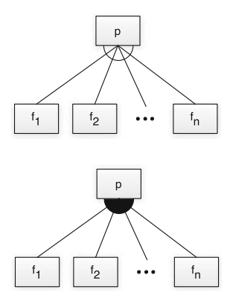
Propositional Logic
Alternative: Choose exactly one
alternative(p, {f₁,...,f_{n}}) ≡ ((f₁ ∨ … ∨ f_{n}) ⇔ p) ∧_{(fi,fj)} ￢(f_{i} ∧ f_{j})
Or: Choose at least one
or(p, {f₁,...,f_{n}}) ≡ ((f₁ ∨ … ∨ f_{n}) ⇔ p)
Notes:
The alternative constraint defines a one-out-of-many choice (xor) and is denoted by an empty arc in graphical feature diagrams. The definition alternative has as first parameter the parent feature p and as second parameter a non-empty set {f1,...,f_n} of child features. Mapped to propositional logic, this is a disjunction, in which, at least, one child feature is selected when the parent is chosen (first half of equation, go over). Additionally (second half of equation), we ensure for each pair of child features that no two child features are selected together -maintaining the exclusive choice - that adds an AND for all pairs of features saying they won’t be there together. An unrestricted choice or “or”, denoted by a filled arc in feature diagrams, defines a some-out-of-many choice. Again, the definition choice(p,{f1,...fn}) has as second parameter a non-empty set of child features. Mapped to propositional logic, the selection of p is equivalent to a disjunction of the child features, where we choose at least one - the first half of the alternative constraint. Now, these examples have been between a parent and child, but can be expressed between any pair of features. We can also define arbitrary propositional formulae between any two features.

Slide 34
Propositional Logic
Cross-tree Constraints are predicates imposing constraints between features.
DataDictionary ⇒ String
(Storing a data dictionary requires support for strings)
MinimumSpanningTree ⇒ Undirected ∧ Weighted
(Computing a Minimum Spanning Tree requires support for undirected and weighted edges)
Constraints over Boolean variables and subexpressions.
(i.e., (NumProcesses >= 5))
Notes:
The notational elements of feature diagrams support a natural description of a wide range of variability options, but not all. More general restrictions are needed in the form of propositional logic constraints. Typical constraints are implications between features located in different parts of the feature hierarchy, for example, to express that a certain algorithm requires a special data structure or that a certain function is not available for a certain operating system. Those additional constraints may span large parts of the feature diagrams and so we call them cross-tree constraints. for example, For embedded data management, storing an explicit data dictionary requires the support of the String data type to store attribute names (2), or For a graph library, a typical cross-tree constraint would be that the computation of minimal spanning trees requires undirected, weighted edges to be supported (4). LArgely, we will focus on named Boolean features as an introduction, but non-Boolean features or attributes of features may also be of interest. For example, in a system supporting parallelization, the number of supported processes may lead to different products, and we might have constraints defined over the number of processes

Slide 35
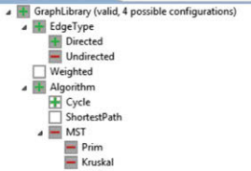
Valid Feature Selection
Translate model into a propositional formula φ.
Assign true to each selected feature, false to rest.
Assess whether φ is true.
If yes, valid selection.
Notes:
A question that we can answer easily is whether a given feature selection is valid for a given feature model. To this end, we translate the feature model into a propositional formula φ (phi). A feature selection is valid if and only if the interpretation of the formula, in which we assign true for every selected feature and false otherwise, is a valid solution to the formula. In other words, we substitute every variable corresponding to a selected feature by true and every other variable by false; the selection is valid if the overall formula, φ, is true. The operation is computationally very cheap (linear in the size of φ). A typical application of this analysis is during the requirements-analysis phase of application engineering - where we are building a concrete product. When a user selects features, we can give immediate feedback whether the current selection is valid. We don’t even need a SAT solver - just plug in what we did to the formula. For example, this is implemented already in the configuration dialog of FeatureIDE (sorry for the blurry screenshot). Next to the root feature, FeatureIDE indicates whether the current selection is valid. in addition, the red “-” shows features we cannot select given our current selections (undirected can’t be chosen because we chose directed, MST can’t be chosen because we selected directed and it needs undirected)

Slide 36
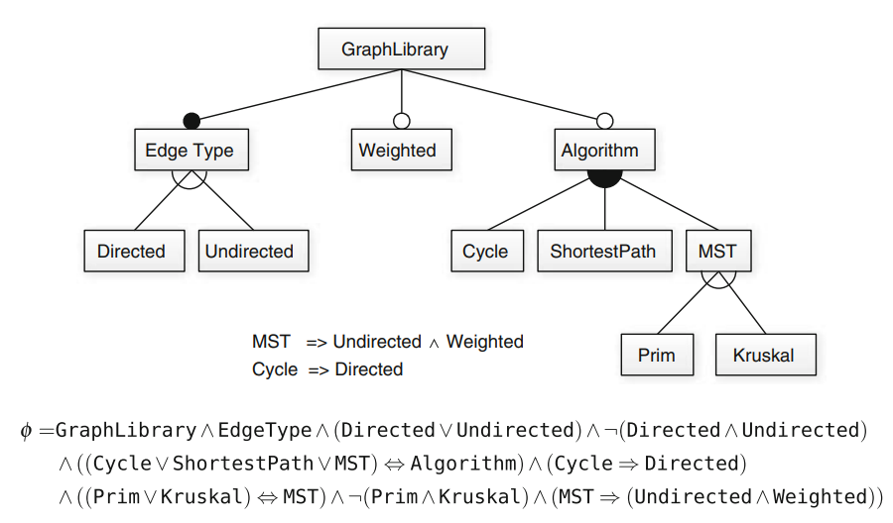
Example - Graph Library
Notes:
Here, we show a subset of the feature model of our graph example and its corresponding propositional formula φ (phi). (go over graph (required edge type, weights/algo options, algorithm is OR, edge type and MST type are XOR, two cross-tree constraints (cycle, MST)). This graph translates into this propositional formula, which incorporates the choice types and cross-tree constraints (go over)

Slide 37
Example - Graph Library
Selection:
{GraphLibrary, EdgeType, Directed}
φ = T ∧ T ∧ (T) ∧ ￢(F) ∧ (T) ∧ (T) ∧ (T) ∧ ￢(F) ∧ (T)
Notes:
To check whether {GraphLibrary, EdgeType, Directed} is a valid selection, we substitute all variables of φ with the corresponding assignment Does this work? (go over, all are true) (click) This is an acceptable feature selection. Again, no SAT solver, we can make substitutions of true and false and check the result of evaluating the complete formula assignment. Let’s try another

Slide 38
Example - Graph Library
Selection:
{GraphLibrary, EdgeType, Directed, Undirected}
φ = T ∧ T ∧ (T) ∧ ￢(T) ∧ (T) ∧ (T) ∧ (T) ∧ ￢(F) ∧ (T)
Notes:
Now, we want to see if {GraphLibrary, EdgeType, Directed, Undirect} is a valid selection. We again start with substituting all variables of φ with the corresponding assignment (click) Does this work? (go over, NOT all are true - violate the constraint on both odirected and undirected being true at once) (click) This is not an acceptable feature selection. Again, make substitutions of true and false and check the result of evaluating the complete formula assignment and see if it works

Slide 39
Consistent Feature Models
A consistent model has 1+ valid selections.
Inconsistent models do not have any valid selection.
Contradictory constraints are common.
Find feature selection that results in φ = true
NP-complete problem, but SAT solvers can often find solutions quickly.
Notes:
The next question we attempt to answer is: Is there any valid feature selection for a given feature model? We say a feature model is consistent if it has at least one valid feature selection; otherwise, we say the feature model is inconsistent. In a model with many cross-tree constraints, such question is not trivial to answer; adding contradictory constraints by accident can easily happen. Naively, we could automatically check all possible feature selections until we find a valid one. This does not scale to larger models, and as a result, determining whether a featrure model is consistent is an NP-complete problem, meaning that there is no guaranteed efficient algorithm. In practice, we encode the question as a Boolean satisfiability problem and use a SAT solver to compute the answer. To ask whether a feature model is consistent, we simply determine whether its Boolean representation φ is satisfiable (SAT(φ)). Modern SAT solvers can solve many of these problems with great efficiency and can also output the first valid feature selection they find (that is, a solution to the formula). SAT solvers use algorithms that efficiently search the state space for a valid assignment, avoiding dead ends.

Slide 40
Let’s Take a Break
Notes:
Just start with a question - want you to start thinking about this. (read)
This isn’t something with one answer, or even a right answer. It’s something we’ll keep returning to

Slide 41
Implementation of Variability
Notes:
Just start with a question - want you to start thinking about this. (read)
This isn’t something with one answer, or even a right answer. It’s something we’ll keep returning to

Slide 42
Variability
The ability to derive different products from a common set of assets.
Implementation: How do we build a custom product from a feature selection?
Binding Time
Technology (Language vs Tool-Based Implementation)
Representation (Annotation vs Composition)
Notes:
To implement software product lines efficiently, the underlying code has to be vari- able. Variabillity is a very general concept, so as a reminder, we define it specifially as the ability to derive different products from a common set of artifacts. Software design is drive by the needs of the stakeholders, manifested in features they want in a product. Instead of serving the needs of a particular stakeholder by developing a product from scratch, variable software can be tailored to stakeholder requirements. There are three dimensions we consider when looking at variability implementation techniques: Binding time, technology, and representation. We’ll introduce each, then look at some specific ways that we take these assets and product complete, customized software

Slide 43
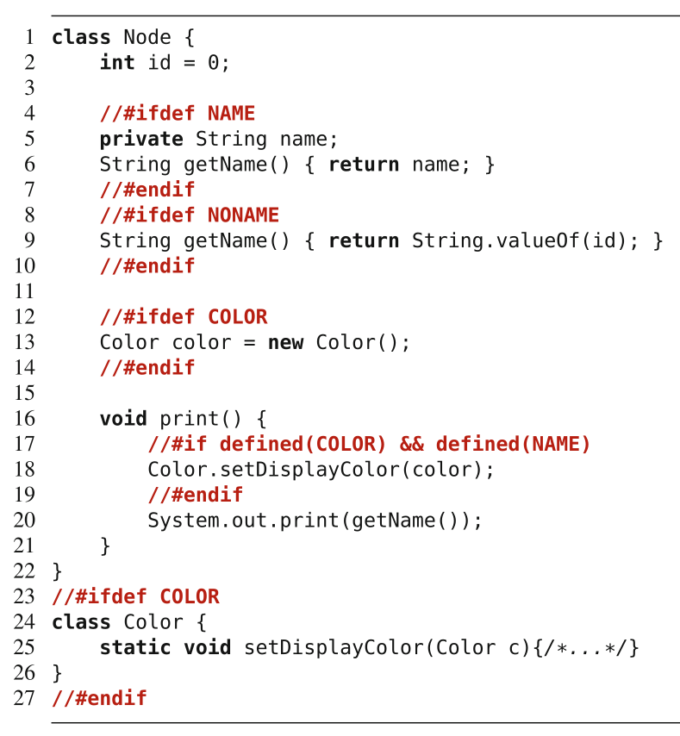
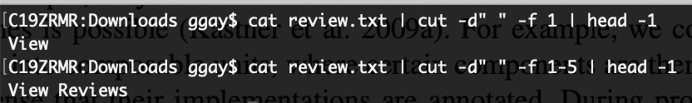
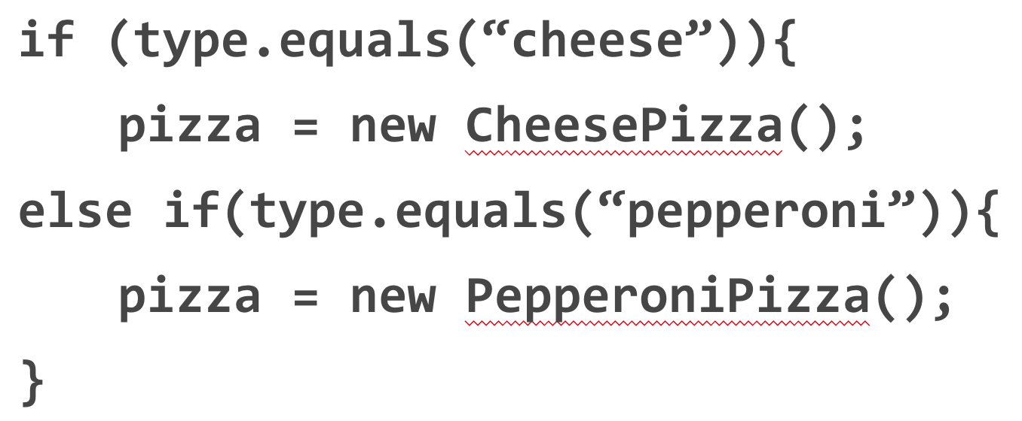
Binding Time
Compile-time Binding
Decisions made when we compile.
#IFDEF preprocessor in C/C++.
Load-time Binding
Decisions made when program starts.
Configuration file or command-line flags.
Run-time Binding
Decisions made while program runs.
Method or API call.
Notes:
When we derive a product, we make decisions; we decide which features will be included in the product or not. We say that we bind a decision. Different implementation techniques allow binding decisions at different times. We can distinguish between compile-time binding (also called static binding or static variability), load-time binding, and run-time binding (also called dynamic binding or dynamic variability). With an implementation technique that supports compile-time binding, developers make decisions of which features to include at or before compile time, when we invoke the compiler. Code of deselected features is then not even compiled into the product, giving us this lean executable.We’ve seen examples a couple of times with IFDEF in C and C++, where we use preprocessors - notes left in the code - that determin what to compile. With an implementation technique that enables load-time binding, developers can defer feature selection until the program is actually started. That is, during compilation all variations are still available; they are decided after deployment, for example, through command-line parameters or configuration files. Some techniques support run-time binding, where decisions are deferred to run time and may even change during program execution ( reconfiguration triggered by external or internal input through method or API parameters). Some implementation mechanisms support mul- tiple binding times.

Slide 44
Binding Time
Compile-time binding improves performance.
… but executable cannot be configured further.
Load-time binding configured at execution.
Run-time binding can be configured any time.
… but results in reduced performance, security hazards, and program complexity.
Notes:
The different binding times each have advantages and disadvantages. Typically, compile-time binding leaves room for more optimizations. All unnecessary code can be removed from the product, reducing run-time overhead in terms of binary footprint, memory consumption, and execution time. However, once the product has been generated and deployed, it is not variable any more—that executable cannot change, and either that customer loses the ability to customize further, or at minimum, you need to compile again. A product with load-time variability is more flexible to reconfigure. Instead of recompiling a new product after each change, end users can modify command line parameters or the configuration file and restart the same executable. A product in which variability decisions are even delayed to run time is able to react immediately, without restart, by adapting its behavior, giving ultimate flexibility. However, mechanisms for load-time and run-time binding often incur a memory and performance overhead, since all variations are compiled into a single executable and consistency conditions must be checked at run time. Including unnecessary functionality in a shipped product may also be considered as potential security threat. It can lead to undesired feature interaction, and requires much more careful testing. So, there is a trade-off to be made.

Slide 45
Technology
Language-based Implementation
Use programming language mechanisms to implement features and derive product.
Pass parameters at run-time.
Tool-based Implementation
Use external tools to derive a product.
Use preprocessor to compile only the requested features.
Notes:
Technology-wisex We have two main routes we can take, classifying different product-line implementation techniques into those that are based on mechanisms provided by a programming language, called language-based approaches, and those that are based on tools that operate on software artifacts to derive products, called tool-based approaches. A language-based approach uses the mechanisms provided by a host programming language to implement features and to derive products. A tool-based approach uses one or more external tools to implement or repre- sent features in code and to control the product-derivation process. A classic language-based approach is to implement variability with run-time parameters. A classic tool-based approach is to use a preprocessor that transforms software artifacts based on a given feature selection. You cannot always draw a sharp line between language-based and tool-based approaches, but this rough distinction is enough to structure our discussion.

Slide 46
Annotation-Based Representation
All code in common code base.
Code related to a feature marked in some form.
Preprocessor annotations, if-statement that checks input.
Code belonging to deselected features ignored (run-time) or removed (compile-time).
Adds complexity, reduces modularity/readability.
Notes:
A major goal of product line engineering is to derive a product automatically from variable code, based on a user’s feature selection. So, product derivation involves product generation, statically or dynamically. There are two main ways to represent variability and variation points, and how products can be generated: annotation-based and composition-based approaches. In annotation-based approaches, the code of all features is merged in a single code base, and annotations mark which code belongs to which feature. In some sense, an annotation maps a program element to the feature or feature combination it belongs to. A standard example is implementing variable code using the C preprocessor, those IFDEF examples. The C or C++ code comprises the code of all products, and preprocessor directives within the C code control which code fragments are included or excluded upon a feature selection (by setting preprocessor constants). Also the use of parameters that control and alter the behavior of a program at run time can be viewed as a form of annotation too . In this case, an if statement that executes code depending on the feature selection plays the role of an annotation. During product derivation, all code that belongs to deselected features or invalid feature combinations is removed (at compile time) or ignored (at run time) to form the final product. Annotation-based approaches are widely used in practice because they are easy to use and already natively supported by many programming environments. These are what we are going to focus on mainly when we talk about implementation. However,, preprocessor-based and parameter-based implementations are also criticized for their potential complexity, lack of modularity, and reduced readability compared to proposed composition-based approaches.

Slide 47
Composition-based Representation
Code belonging to feature in dedicated location.
Class, file, package, service
Selected units combined to form final product.
Requires clear mapping between features and units
Can combine annotation and composition.
Annotation-based approaches remove code.
Composition-based approaches add code.
Notes:
Composition-based approaches locate code belonging to a feature or feature com- bination in a unit of some kind - a dedicated file, pacakge, class, service, or module. During product deriva- tion, all units of all selected features and valid feature combinations are com- posed to form the final product. A classic example is a framework that can be extended with plug-ins, ideally one plug-in per feature; different products can be generated by integrating different plug-ins. The key challenge of composition-based approaches is to keep the mapping between features (problem space) and composition units (solution space) simple, ideally one-to-one. If each feature has its own imple- mentation in the form of a composition unit, a generator can simply include the corresponding unit in the composition when a feature is selected. In principle, a combination of annotation-based and composition-based approaches is possible and some blending is normal. For example, we could decompose a system into composable units, where certain components are themselves variable in the sense that their implementations are annotated. During product derivation, a generator would select a subset of composition units and remove annotated code from them that belongs to deselected features. Another way to view the difference between annotation and composition is that annotation-based approaches support negative variability (code is removed on demand), and composition-based approaches support positive variability (compo- sition units are added on demand).

Slide 48
Some Examples
Preprocessors
Compile-time, tool-based, annotation-based
Parameters
Load or run-time, language-based, annotation-based
Design Patterns
Load or run-time, language-based, composition-based
Notes:
We will discuss different approaches to implementing variability, but three core examples are preprocessor-based implementation, parameters, and design patterns. (go over)

Slide 49
Preprocessors
Optimize code before compilation.
Often used by compilers to produce faster executable.
Can selectively include or exclude code.
Most famous - cpp
“The C Preprocessor”
Exist for many languages.
Notes:
A preprocessor is a tool that manipulates source code before compilation, with the intent of optimizing the final executable in some form - whether for speed or, in our case, to configure that executable for a particular use. A popular preprocessor is the C preprocessor cpp, which is used in almost every C and C++ project. Most of the examples we’ve seen of this are using cpp so far. cpp provides directives to inline files, to define macros, and to remove code frag- ments based on user-defined conditions. In addition to cpp, many other preprocessors exist, we will talk about Antenna in Java. Important in product line or variable systems development, preprocessors typically provide facilities for conditional compilation, where marked code fragments in the source code are conditionally removed before compilation— #ifdef and #endif in cpp (go over example a little). Conditional compilation is probably the most common mechanism for implementing variability in product lines in industrial practice. This is the prototypical example of tool-based, compile-time, annotation-based variability implementation.

Slide 50
Implementation with Antenna (Java)
Annotate code using comments:
//#if FEATURE_NAME
If FEATURE_NAME is chosen, include this code.
//#elif OTHER_FEATURE
else if OTHER_FEATURE chosen, include this code.
//#else
//#endif
Instead of removing lines, Antenna comments out lines, inserting //@
Notes:
Antenna is a preprocessor for Java which uses the following directives to annotate optional code: #if expression, #elif expression, #else, and #endif (explain each). Additionally, a whole file can be annotated at once using the directive #condition expression in the first line of the file. Instead of a removal of the specific lines, Antenna uses //@ comments for the deactivation of code. Therefore, it is also possible for Antenna to use the same files as input and output to cleanly transform code.

Slide 51
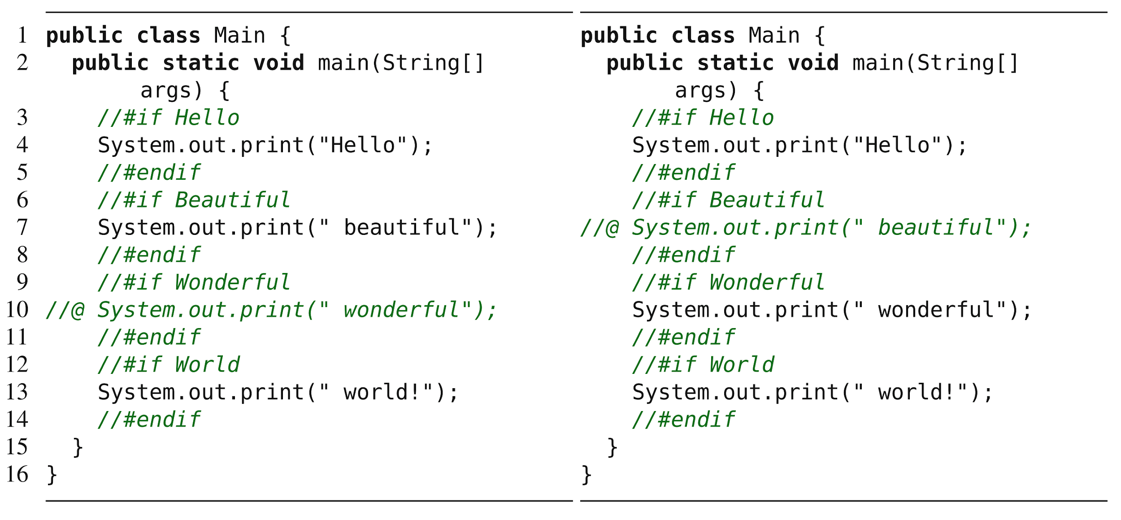
Examples
(Hello, Beautiful, World) (Hello, Wonderful, World)
Notes:
Left - we chose features Hello beautiful world, right hello wonderful world - point out annotations and commented code

Slide 52
Parameter-based Implementation
Use conditional statements to alter control flow based on features selected.
Boolean variable based on feature, set globally or passed directly to methods:
From command line or config file (load-time binding)
From GUI or API (run-time binding)
Hard-coded in program (compile-time binding)
Notes:
We can start to talk about implementing variability in the code with the simplest method, and work our way up to more complex methods. A simple way to implement variability is to use conditional statements (such as if and switch) to alter the control flow of a program at run time based on the selections made for each variation point. In our context, conditional statements are typically controlled by configuration parameters passed to a method or a module, or set as global variables in a system. Different parameter assignments lead to different verisons - different configurations of a program when it is executed. There are many ways to set configuration parameters. In general, we expect one Boolean parameter per feature, either set globally or at an appropriate level of scoping. These variables should, ideally, be named in a way that directly maps to the feature model. Often, command-line para- meters (such as in “ssh -v”) or configuration files (such as system.ini or httpd.conf) are read at startup and stored in global variables. This is an example of load-time binding - we make choices when the program is executed, by passing in our choices from the command-line or using this configuration files. In other cases, users can change parameters in a GUI using preference dialog boxes or as part of an API request - such as a POST request to a REST api, sometimes with immediate effects - run-time binding - or at other times requiring a restart - load-time. In a third, rarer case, values of variables can also be hard-wired in source code, so changing them requires recompilation - AKA a compile-time binding. So, the use of parameters is a flexible approach, simply noting in the code how to make use of these parameter settings.

Slide 53
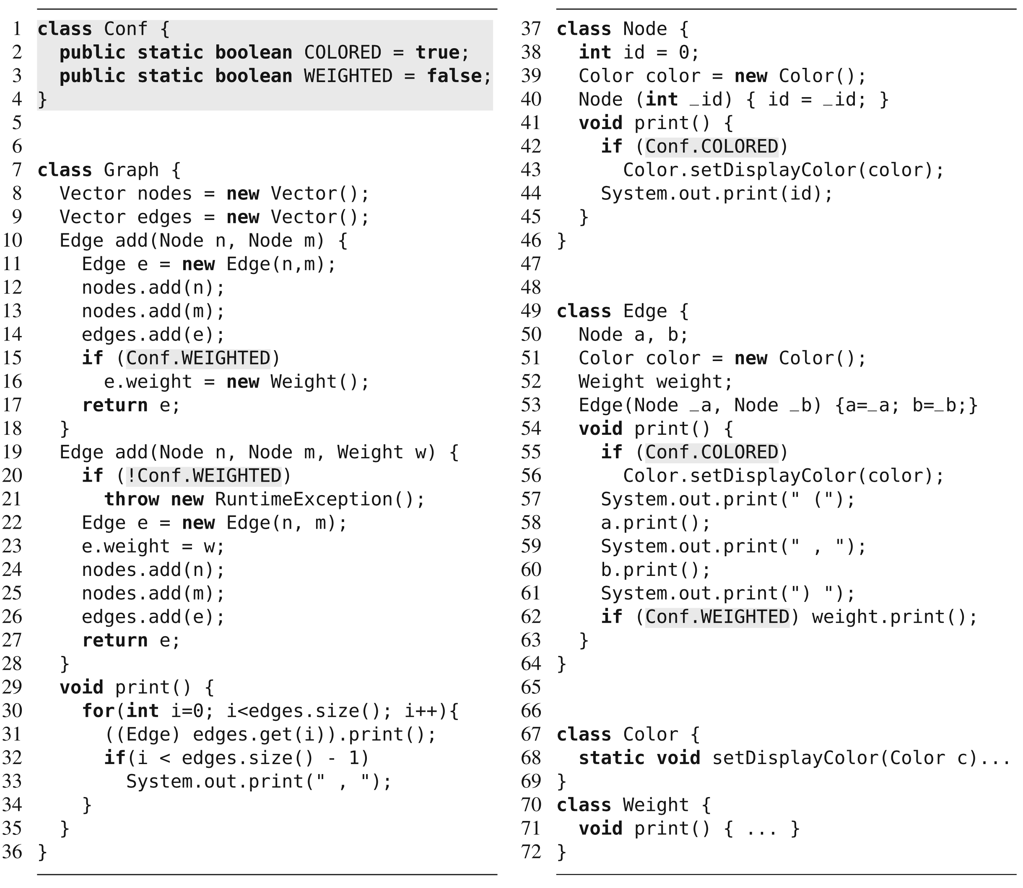
Choices read from command line and stored in Conf.
Other classes check variables and invoke code appropriately.
Notes:
This is pretty simple, and has its benefits and drawbacks. we show our graph example with two configurable features, Weighted and Colored, implemented as global configuration parameters. Class Conf stores two parameters, possibly initialized during startup from command-line parameters or from configuration files. W read in the choices from the user at load time, store the values in these parameters. These parameters are evaluated inside if statements in the classes Graph, Node, and Edge to trigger feature-specific behavior on demand.

Slide 54
Design Patterns
Notes:
Just start with a question - want you to start thinking about this. (read)
This isn’t something with one answer, or even a right answer. It’s something we’ll keep returning to

Slide 55
Design Patterns
Patterns for implementing OO design lessons.
Class interface and structuring guidelines that structure how variable elements are implemented.
Load or run-time, language-based, composition-based.
Strategy, Factory, Decorator, Adapter, Facade, Template Method Patterns
Notes:
Today, our focus is on variability implementation via design patterns. Design patterns are a load or run-time bound, language-based, composition-based approach for variability implementation. That is - we choose feature either when the program is executed or while it runs, it is implemented using language mechanisms instead of external tools, and features are encapsulated as seperate units that we merge together, rather than having code for multiple features mixed in the same place. Design patterns are descriptions of collaborating objects and classes that are customized to solve a general design problem in a particular context. They are essentially recipes for implementing certain forms of behavior in a system. Design patterns are a classic OO Design technique, and have a major place here as one of the easiest ways to implement reusable assets in a seemless and extendable way, to allow your system to evolve over time by slotting in new features and controlling how the system evolves. I highlighted six patterns - some complex, some deceptively simple - that are particularly suited to product lines and other long-term evolving systems. Design patterns are one of the major means of language-based implementation.

Slide 56




Strategy Pattern
Defines family of algorithms, encapsulates them, makes them interchangeable.
Notes:
Behavioral pattern. Algorithms describe behaviors. You take those, implement them, and make them interchangable by ensuring they all offer the same interface. Can swap one form of flying for another at runtime, don’t need to know specifics. This allows seemless mangement of variability - just attach the right option at runtime, call as you would call any option, and it should work. You can add in new assets - new behaviors - to that set over time and make use of them by binding the appropriate class at runtime.

Slide 57
Strategy Pattern
Principle: Favor composition over inheritance.
Duck
FlyBehavior flyB
QuackBehavior quackB
quack()
fly()
swim()
display()
setFlyBehavior()
setQuackBehavior()
<<interface>>
FlyBehavior
fly()
FlyWithWings
fly() { .. }
FlyNotAllowed
fly() { .. }
<<interface>>
QuackBehavior
quack()
MallardDuck
display() { .. }
RedheadDuck
display() { .. }
RubberDuck
display() { .. }
NormalQuack
quack() { .. }
Squeek
quack() { .. }
Notes:
This pattern embodies a principle of OO programming. Often, we should favor composition over inheritance. Now, a duck has a flying behavior, it has a quacking behavior. But, instead of inheriting behavior from parent classes and making overrides, we have implemented the behaviors once and composd new versions of a class from the right building blocks.
We restrict a duck to what is true of all ducks, then build a new duck from the right set of behaviors.
This is the principle of composition - building a class from small independent blocks - something we have repeated over an over when talking about product lines. Inheritance can be great, but only for those things that are shared between a parent and all children. Composition is better for those aspects that vary and can change over time. Often has-a can be better than is-a.

Slide 58
Factory Pattern
Defines interface for creating an object, lets subclasses decide which object to instantiate. Allows reasoning about creators and products.
<<interface>>
Pizza
prepare()
bake()
cut()
box()
<<interface>>
PizzaFactory
createPizza(String)
NYVeggiePizza
prepare()
bake()
cut()
box()
ChicagoVeggiePizza
prepare()
bake()
cut()
box()
NewYorkPizzaFactory
createPizza(String)
ChicagoPizzaFactory
createPizza(String)
Notes:
The factory pattern gives us a way to encapsulate the instantiations of concrete types. Lets us reason in terms of two parallel class hierarchies - creators and products - factories encapsulate object creation by letting subsclasses decide which objects to create. All creators let us pass in options, use those to instantiate an object, then pass the right object back. The object we create - the products - may differ in the result of the methods they offer, but all offer a common set of methods.

Slide 59
Factory Pattern - In Practice
Each factory manages a subset of the products.
Client
Each type of product has a defined interface.
<<interface>>
Factory
createProductA()
createProductB()
<<interface>>
ProductA
// methods
<<interface>>
ProductB
// methods
ConcreteFactory1
createProductA()
createProductB()
Concrete
ProductA1
Concrete
ProductB1
Concrete
ProductA2
ConcreteFactory2
createProductA()
createProductB()
Concrete
ProductB2
Notes:
So, what does this look like in a more general form? We have a client, who is concerned with both factories and products.
For each product type we build, we have an interface that states operations that can be assumed of that type of product. These do not have to be the same operations. Rather, we are just providing an interface for each type of product. So, if we make pizzas and sandwiches. We have an interface for pizza. We have an interface for sandwich. All pizzas follow the same interface. All sandwiches follow the same interface. Then, we have concrete product classes for each type that implement those methods of the appropriate interface. A factory interface defines creation methods for each product type, be that pizza or burger or sandwich. So, each factory is responsible for creating certain subset of concrete products, and links to the products it creates. Other factories handle other subsets of the products.

Slide 60
The Decorator Pattern
Attaches responsibilities to an object dynamically.
Flexible alternative to subclassing.
Decorators have same supertype as decorated object.
One or more decorators can wrap an object.
Can pass decorated object in place of the original.
Decorator adds its own behavior before or after calling wrapped object.
Notes:
The Decorator Pattern attaches additional responsibilities to an object dynamically. This is a flexible alternative to inheritance when you want to extend functionality without modifying the code.
Decorators provide a flexible alternative to subclassing for extending functionality. Decorators have the same supertype as the objects they decorate. And, given that use of polymorphism, by inheriting from the same supertype, we can We can pass a decorated object in place of the original object. This is a key point - The decorator adds its own behavior before or after asking the wrapped object to do the rest of the job. We get functionality from the wrapped objects, then perform any additional work that needs done without touching the code of the wrapped object.

Slide 61
The Decorator Pattern
Each Decorator offers same methods the Component offers.
Component
behavior()
// Other methods
Decorators add new behaviors to Components
ConcreteComponent
behavior()
// Other methods
Decorator
behavior()
// Other methods
Each concrete Decorator has instance variable to store wrapped component.
ConcreteDecoratorA
Component wrapped
behavior()
newBehavior()
// Other methods
ConcreteDecoratorB
Component wrapped
Object newAttribute
behavior()
// Other methods
Decorators add behavior by adding operations and attributes.
Notes:
What does this look like in code? We have two concepts - Components, what gets decorated - and Decorators, what wraps around a component. We deal with two levels of inheritance. (click1) We create a base Component that all concrete components inherit from. This is like the Beverage and HouseBlend, Espressor, and Dark Roast. The components are what we dynamically add new behavior to. (click2) Then, we have a base Decorator that defines what all Decorators must offer. Since it inherits from Component, all Decorators will offer the methods that all Components offer, in addition to anything they add. (click3) Decorators contain an instance variable to store the object being decorated. That’s how we keep track of what is being wrapped. We can infinitely keep wrapping, we just maintain a pointer to the next layer down until we reach the center. (click4) Decorators can also add new behavior by adding additional attributes and operations. That said, new behavior is typically added by doing computation before or after calling an existing method in the component, like we did with the cost on the previous slide.

Slide 62
The Adapter Pattern
Converts an interface into interface client expects.
Adapter’s methods call corresponding methods from adaptee.
If adaptee changes, only the adapter needs to change.
No changes needed to classes that call adapter.
Your Existing System
Adapter
External System
Notes:
Adapter Pattern converts the interface of a class into the interface the client expects. Adapters let classes work together that despite incompatible interfaces. The pattern allows us to use a client with an incompatible interface by creating an adapter that does the conversion. This acts to decouple the client from the implemented interface, and if that interface ends up changing over time, the adapter encapsulates the change so that the client doesn’t need to be modified every time it needs to operate against a different interface. This is a big deal for code reuse, allowing us to build a system out of independent external code far more easily. Now, that example had the adapter wrapped around one adaptee - the turkey was adapted to match the interface of a duck.

Slide 63
The Adapter Pattern
Adapter implements target interface.
Client
<<interface>> Target
request()
The client sees only the target interface.
Adapter
Adaptee adaptee
request()
Adaptee
specificRequest()
Requests get delegated to Adaptee.
Adapter composed with Adaptee.
Notes:
Here is what the pattern looks like in the abstract.
- (read bubbles)
Lot of good OO principles at work here. We use object composition to wrap the adaptee with an altered interface. We can even use the adapter with any subclass of the adaptee. This pattern binds the client to an interface, not a particular implementation. We could even write several, situationally-appropriate adapters, each converting a different backend set of classes.

Slide 64
The Facade Pattern
Create a new class that exposes simple methods (the facade).
Facade calls on classes to implement high-level methods.
Client calls facade instead of classes.
Classes still accessible.
HomeTheater
Facade
startMovie()
endMovie()
startSpotify()
endSportify()
startRadio()
endRadio()
Amplifier
BluRayPlayer
Tuner
Stereo
Lights
Projector
Screen
PopcornMaker
Notes:
So, what we want to do is Create a new class HomeTheaterFacade that exposes a few simple methods., things like startMovie or startSpotify() - high level things - functionality - we might want to perform using this set of underlying classes. Facade treats the home theater components as a subsystem and call on the subsystem to implement its methods. so, rather than includingthat sequence of commands to start a movie, you take those and implement them once in a method in the facade, then never have to reuse that whole sequence again when using the system later, just call the method in the facade instead. Client code calls methods on the facade instead of the individual subsystem classes, so it acts as an interface. We no longer have to communicate directly with the amplifier or the lights, we can communicate through the facade, reducing coupling on the individual classes of the system.
Facade still leaves the individual classes accessible to use directly.. If you need the advanced functionality, it’s still there and ready to be used, but the rest of the time, it simpifies our code and decouples the subsystem from the client code, easing change - if change occurs, we can change the facade instead of client code calling into the individual classes.

Slide 65
The Facade Pattern
Provides a unified interface to a set of classes.
Facade defines a high-level interface that makes a subsystem easier to use.
Provides an additional method of access.
Multiple facades may provide situational functions.
Decouples client from any one subsystem.
Notes:
The Facade Pattern provides a unified interface to a set of classes in a subsystem. Facade defines a higher-level interface that makes the subsystem - the collected set of classes- easier to use.
There is no encapsulation going on here, no hiding of information. Instead, we’re just offering one more method of access. This is a nice property of the Facade pattern - we provide a simplified interface while still exposing the full functionality of the system to those who want it. Multiple facades may be defined for the same subsystem - the same classes - even to provide different situational functions. This Decouples the client from any one subsystem. Say you add a new home theater component. You just need to change the facade, rather than the code in the client system.

Slide 66
Modularity
Notes:
Just start with a question - want you to start thinking about this. (read)
This isn’t something with one answer, or even a right answer. It’s something we’ll keep returning to

Slide 67
Learning Objectives
Introduce concepts related to SPLs Modularity
Introduce Frameworks Modular design
Introduce APIs Modular design
Discuss major drivers of design modularity
Main Reference:
Feature-Oriented Software Product Lines: Concepts and Implementation,
Ch.3, Ch.4,
Sven Apel • Don Batory •Christian Kästner • Gunter Saake
Springer-Verlag Berlin Heidelberg 2013, ISBN 978-3-642-37521-7
Other publications (see slides for references)

Slide 68
Modular Concepts
Modularity is a software design technique used to decompose the software into modules. Separating a module from other parts of the software, improving systems traceability, testability, reusability, and deliverability.
Modular programming is a software design technique that emphasizes separating the functionality of a program into independent, interchangeable modules, such as classes and frameworks that contain everything necessary to execute only one aspect of the desired functionality.

Slide 69
Frameworks Framework Function
A framework is a set of classes that embodies an abstract design for solutions to a family of related problems and supports reuse at a larger granularity than classes. A framework is open for extension at explicit hot spots.
A framework provides explicit points for extensions (plug-ins), called hot spots, at which developers can extend the framework.
In the same manner as the template-method, design pattern, and the strategy design pattern, a framework is responsible for the main control flow and asks its application methods for custom behavior, a principle called inversion of control

Slide 70
Frameworks Framework Function
How Frameworks are different from Libraries?
With frameworks, the execution start in the framework’s code, and is the framework who call application methods. This is called Inversion of Control and is one of the key concepts for frameworks and a key distinction between frameworks and libraries.
The golden rule of framework design: Writing a plugin/extension should NOT require modifying the framework source code

Slide 71
Frameworks White Box Frameworks
It consists of a set of concrete and abstract classes. To customize their behavior, developers extend white-box frameworks by overriding and adding methods through sub-classing. A white-box framework can be best thought of as a class containing one or more template-methods that developers implement or overwrite in a subclass.
The “white-box” in white-box framework comes from the fact that developers need to understand the framework’s internals.
On the other, white-box frameworks require detailed understanding of internals and do not clearly encapsulate extensions from the framework; thus, they are criticized for neglecting modularity.

Slide 72
Frameworks Black-Box Frameworks
Black-box frameworks separate framework code and extensions through interfaces. An extension of a black-box framework can be separately compiled and deployed and is typically called a plug-in. In feature-oriented product-line development, ideally, each feature is implemented by a separate plug-in.
Black-box frameworks follow the strategy and observer patterns. The framework exposes explicit hot spots, at which plug-ins can register observers and strategies.
In “black-box” ideally, developers need to understand merely their interfaces, but not the internal implementation of the framework, as the name suggested.

Slide 73
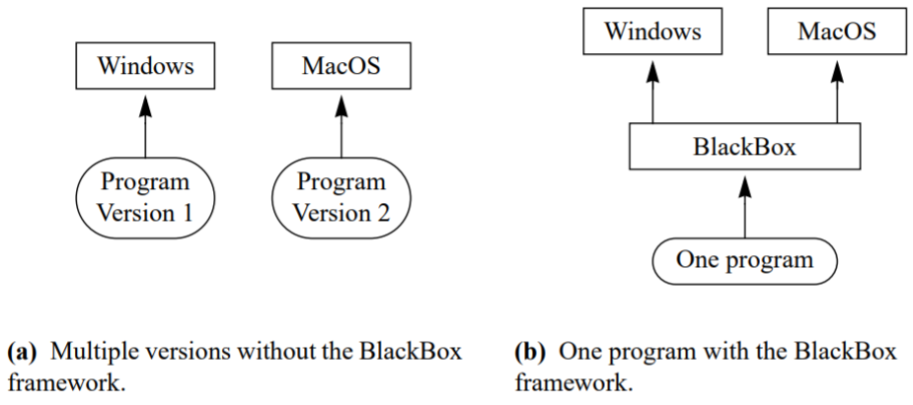
Frameworks Black-Box Frameworks
The decoupling of extensions encourages separate development and independent deployment of plug-ins, as known from many application-software frameworks, including web-browsers or development environments.
As long as the plug-in interfaces remain unchanged, framework and plug-ins can evolve independently.
The cross-platform capability of Black Box

Slide 74
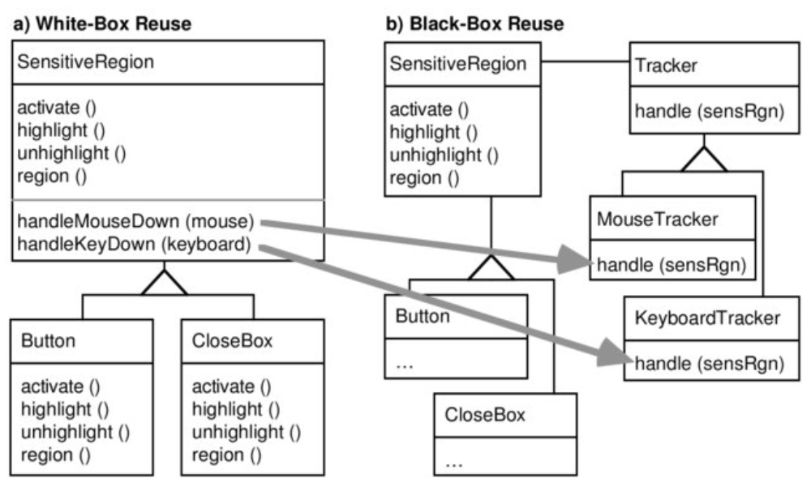
Frameworks Black-Box Frameworks
White-box frameworks consist of concrete and abstract classes. To customize their behavior, we extend the frameworks by overriding and adding methods through sub-classing. However, Black-box frameworks separate framework code and extensions through interfaces.

Slide 75
Modularity Drivers Separation of Concerns SoC
A common approach to attain traceability is to separate features both in design and code, such that the relationship between features and corresponding design and implementation artifacts are explicit.
SoC means factoring out crosscutting concerns into separate modular units.
For example, an extra modular unit may be dedicated to encapsulating the functionality providing data persistence. This functionality can then be used, e.g., through subroutine calls from many different modules.

Slide 76
Modularity Drivers Separation of Concerns SoC
When separating features into distinct artifacts, developers can easily find all code related to that feature for maintenance or evolution tasks. Related pieces of code are implemented together, which is known as cohesion. Cohesive pieces of code are typically easier to reason about than widely scattered code fragments.
Service-oriented design can separate concerns into classes and services.
Procedural programming languages such as C and Pascal can separate concerns into procedures or functions.

Slide 77
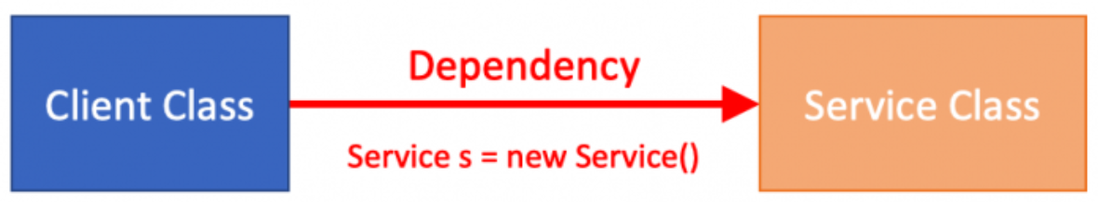
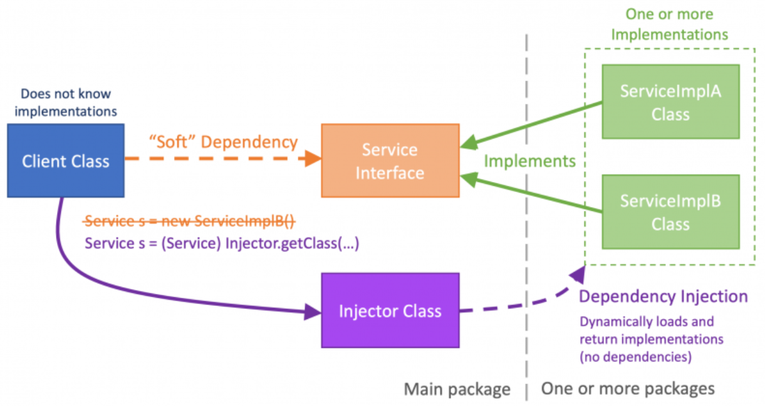
Modularity Drivers Separation of Concerns SoC
Dependencies by injection:
The dependency between the Client
and Service classes*, it happens when the Client becomes tightly coupled with the Service.
However, using an injector class to dynamically load and return the implementation classes. the client only has a dependency to the Service interface and the Injector class.
* https://developer.salesforce.com/blogs/2019/07/breaking-runtime-dependencies-with-dependency-injection.html

Slide 78
Modularity Drivers Cross-cutting Concern
In the 1990s, an insight emerged that a certain class of concerns, called crosscutting concerns, is inherently difficult to separate using traditional mechanisms based on block or hierarchical structure.
Designs based on cross-cutting concerns offer many software engineering benefits, such as separation of concerns, simplified design evolution, and ease of maintenance.
cross-cutting concerns, like logging or security, are difficult to map in a single class and hence they are scattered throughout the code.

Slide 79
Modularity Drivers Cross-cutting Concern
Aspects enable the modularization of concerns that cut across multiple types and objects.
Aspect-Oriented Programming (AOP) introduces the notion of Aspects and shows how we can take crosscutting concerns out of modules and place them in a centralized place.
An Aspect is modular units that cross-cut the structure of other units. Aspects are elements such as security policies and synchronization, optimization, communication or integrity rules that crosscut traditional module boundaries

Slide 80
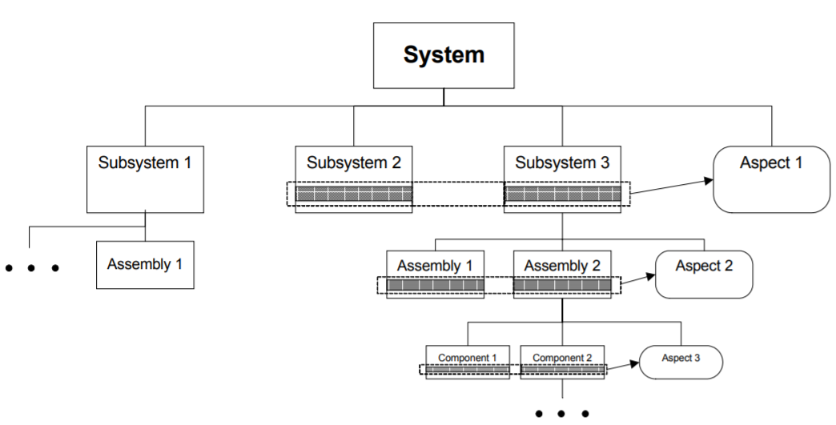
Modularity Drivers Cross-cutting Concern
(AOP) the notion of aspect is defined*, e.g., as “a mechanism beyond subroutines and inheritance for localizing the expression of a crosscutting concern.”
* UML 2002 - The Unified Modeling Language. Model Engineering, Concepts
By Jean-Marc Jezequel, Heinrich Hussman, Stephen Cook

Slide 81
Modularity Drivers Code tangling & scattering
This results in two problems:
Code tangling: — Each class and method contains tracing, transactions, and exception handling — even business logic. In a tangled code, it is often hard to see what is actually going on in a method.
Code scattering — Aspects such as transactions are scattered throughout the code and not implemented in a single specific part of the system.

Slide 82
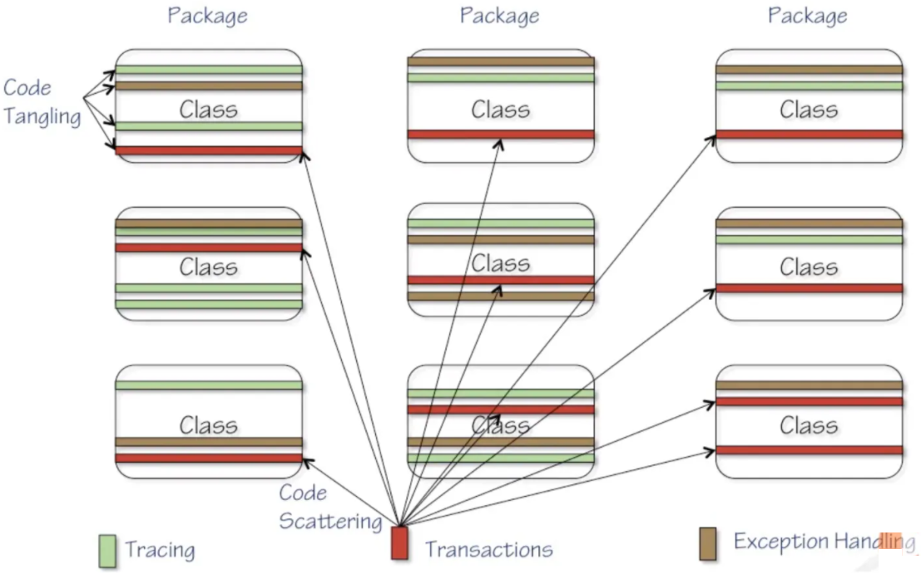
Modularity Drivers Code tangling & scattering

Slide 83
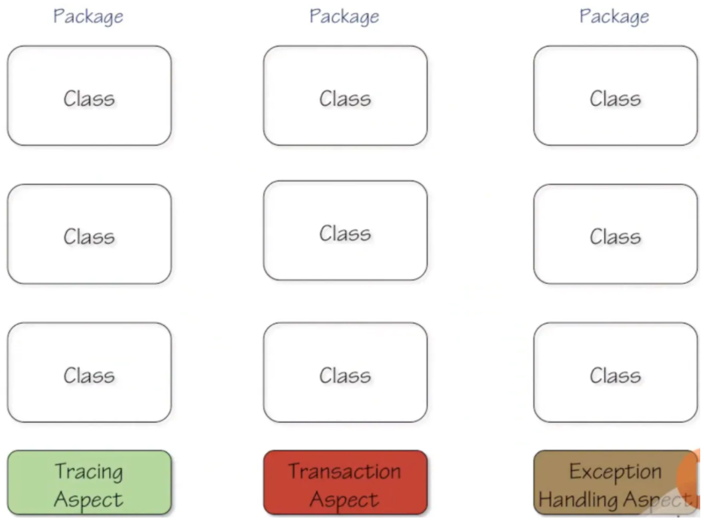
Modularity Drivers Code tangling & scattering
Using AOP allows you to solve these problems.
It takes all the transaction code and puts it into a transaction aspect.
Then, it takes all the tracing code and puts that into a tracing aspect.
Finally, exception handling is put into an aspect.

Slide 84
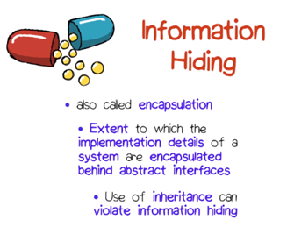
Modularity Drivers Information hiding
Information hiding is the separation of a module into internal and external part.
The internal part remains hidden from other modules, whereas the external part, the module’s interface, specifies the contract of how the module interacts with the rest of the system.
When separating features, we also hide the internals
of their implementation and make all communication
between them explicitly on interfaces.

Slide 85
Modularity Drivers Traceability concern
Traceability improves the understanding of system variability, as well as support its maintenance and evolution.
With large systems the necessity to trace variability from the problem space to the solution space is evident. Modular SPL supports traceability and reduce its complexity, especially with a large features(f) domains (complexity 2^{f}).
It allows a 1-to-1 mapping of variability of Feature model between the problem space and the solution space.

Slide 86
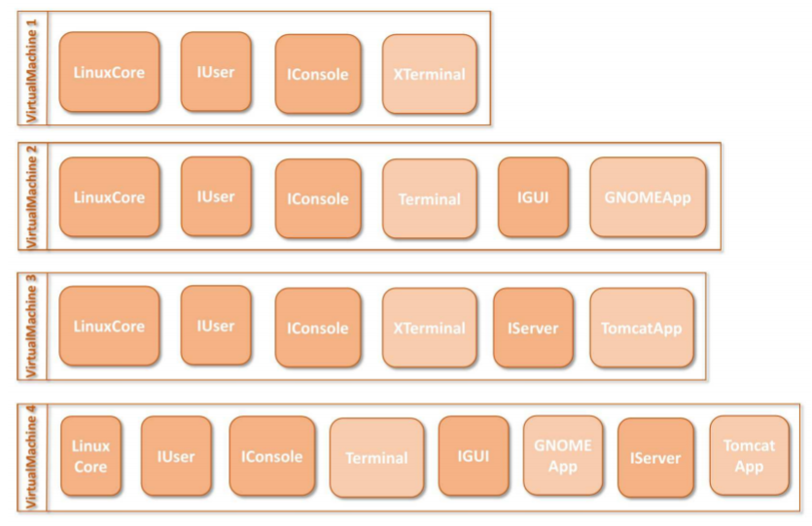
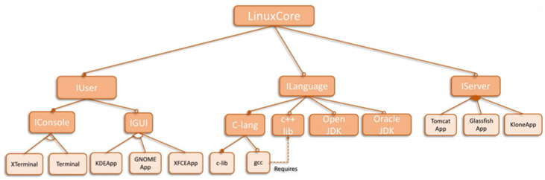
Modularity Drivers Traceability concern
Table shows the traceability relation between the features and the components
FD of Component Model: Linux Virtual Machine Based System
The main advantages of traceability are*:
to relate software artefacts and corresponding design decisions,
to give feedback to architects and designers about the current state of the development,
allowing them to reconsider alternative design decisions, and to track and understand errors.
* https://hal.inria.fr/hal-01342351/document
Notes:
Table 1 shows the traceability relation between the features and the components. The entry in 179 the row of feature Glass f ish means the component Glass f ishApp implements the feature Glass f ish. 180 Similarly, the feature Console can be implemented by the set of components: {IConsole, XTerminal} 181 or {IConsole, Terminal}. For each feature in the client specification, the traceability relation gives 182 the required sets of components. In the feature model, the effective features are only the leaf 183 features. The traceability of a parent feature like the feature GU I can be implemented by the set 184 of components: {IGU I}. The feature GU I can be abstracted by eliminating all of its child features 185 {KDE, GNOME, XFCE}; this allows to analyze the SPL at a higher level of abstraction. Section 3 refer 186 column 3 and 4 from Table 1 to represent the short name for features and components respectively,
Component Model: Similar to a feature model, same notations can be used to represent 167 variability amongst the components present in core assets of an SPL, we call it a Component 168 Model (CM). The variability amongst the components can also be represented by any other models 169 like the Orthogonal Variability Model (OVM), Varied Feature Diagram (VFD) and Free Feature 170 Diagrams (FFDs) [20,32]. The component model in Figure 2 represents the resources available 171 to create a virtual machine. The cloud computing technology will create a virtual machine that Version June 22, 2016 submitted to Entropy 5 of 32 172 contains a set of components required to implement the features present in the client speci f ication. 173 Such set of components is called an implementation. The implementation C={LinuxCore, IUser, 174 IConsole, Terminal, ILanguage, C-lang, c-lib } is valid because it satisfies all the constraints on the 175 component model, so a virtual machine can be created with these components. The implementation 176 C={LinuxCore, IUser, IConsole, ILanguage, C-lang, c-lib } is invalid, because the component Terminal 177 or XTerminal or both are required to satisfy the component model constraints

Slide 87
Modularity (Part 2)
Notes:
Just start with a question - want you to start thinking about this. (read)
This isn’t something with one answer, or even a right answer. It’s something we’ll keep returning to

Slide 88
Learning Objectives
Robotics Modular Architecture
Modular autonomous Robots
Feature-oriented programming
Mapping Modules with Features
Main Reference:
Feature-Oriented Software Product Lines: Concepts and Implementation,
Sven Apel • Don Batory •Christian Kästner • Gunter Saake
Other publications (see slides for references)
Modularity-1
Introduce concepts related to SPLs Modularity
Introduce Frameworks Modular design
Introduce APIs Modular design
Discuss major drivers of design modularity

Slide 89
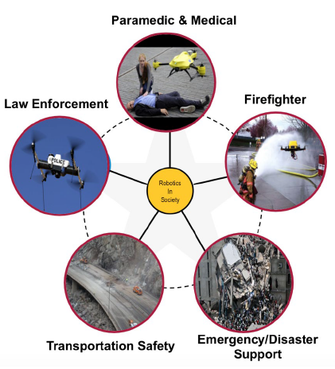
Robotics Domain
Robot as an autonomous agent
An autonomous agent is a system situated within an environment that senses that environment and acts on it, over time, in pursuit of its own agenda and so as to affect what it senses in the future.
Applications:
Agriculture
Logistics
Search & rescue
Onboard sensors:
Camera
Sensors (location)
Infrared

Slide 90
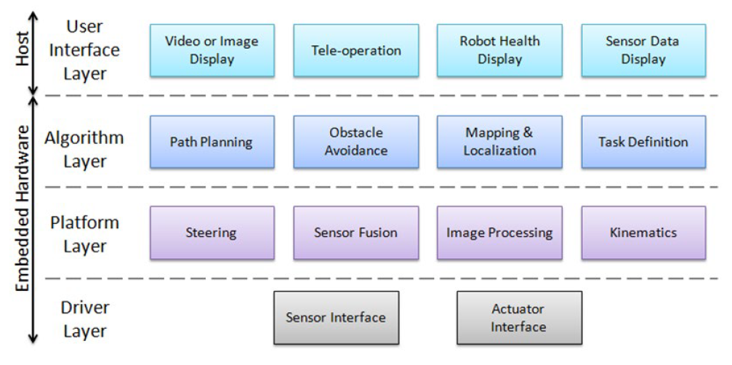
A Layered Approach to Designing Robot Software
Kinematics describes the motion of the bodies and deals with finding out velocities or accelerations for various objects.
An actuator is a component of a machine that is responsible for moving and controlling a mechanism or system, like motor.
http://www.ni.com/white-paper/13929/en/

Slide 91
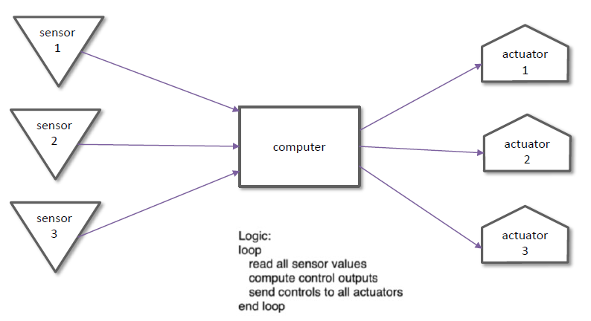
Robotics Modular Architecture
Most Simple Form: Sense, Compute, Control

Slide 92
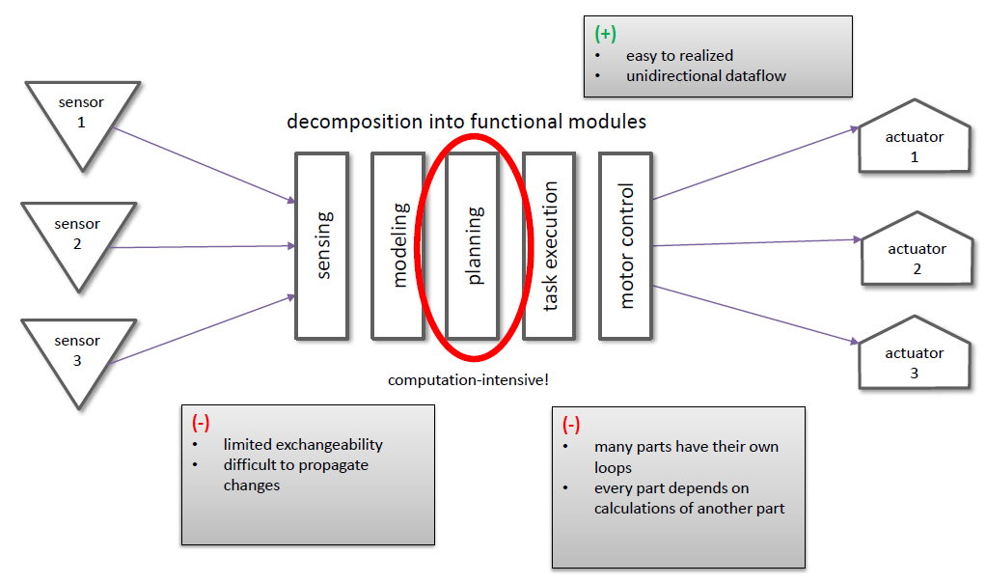
Robotics Modular Architecture
Primitives of Robotics: Sense, Plan, Act
The sense-plan-act (SPA) approach keeps intelligence of the system living in the planning or the programmer, not the execution mechanism.

Slide 93
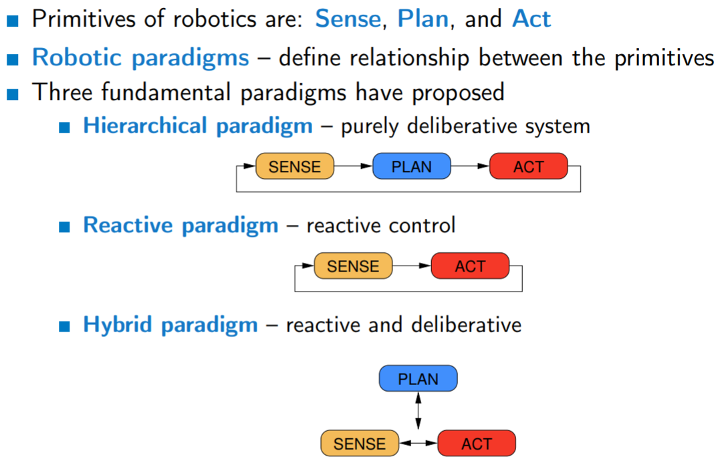
Robotics Modular Architecture
Disadvantages of Hierarchical Model
Planning–Computation requirements is very slow
The “global world” representation has to contain all information needed for planning
Sensing and acting are always disconnected
The “global world” representation has to be updated
The world model used by the planner has to be frequently updated to achieve a sufficient accuracy for the particular task

Slide 94
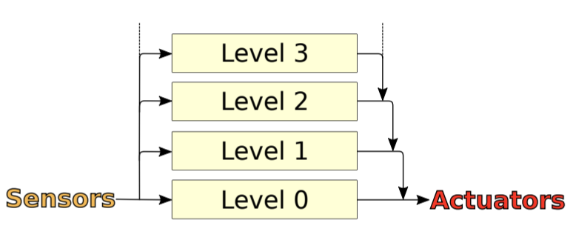
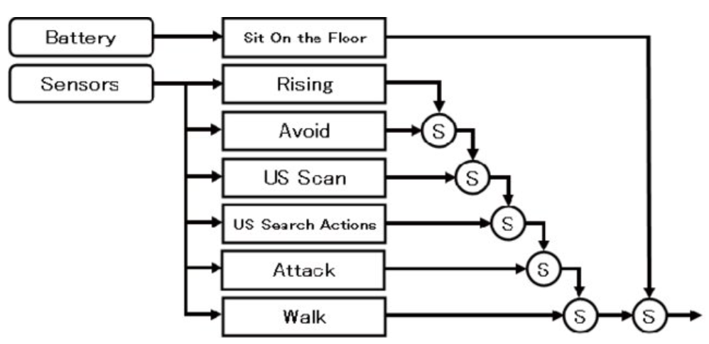
Robotics Modular Architecture Subsumption architecture
Upper layers have precedence over lower layers and subsumes (absorb) the output of lower layers.
Mobile Robot can use layers of a control system for each level of competence and simply add a new layer to an existing set to move to the next higher level of overall competence.
Additional layers can be added later, to add complexity (more features)
The subsumption architecture does not allow for any shared memory or other communication between the layers, making it impossible for the layers to cooperate in order to achieve a common goal

Slide 95
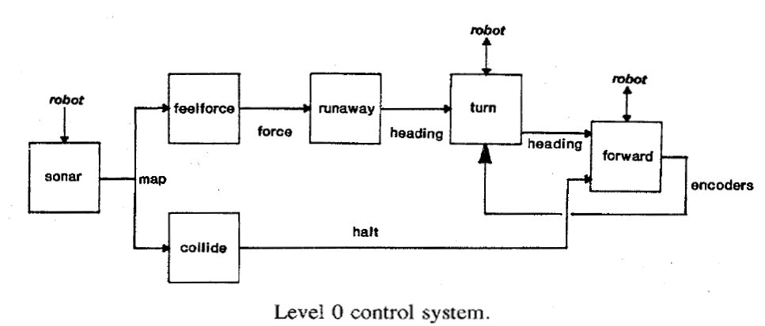
Robotics Modular Architecture Subsumption architecture
The most important problem we found with the Subsumption architecture is that is it not sufficiently modular.
Because upper layers interfere with the internal functions of lower-level behaviors they cannot be designed independently and become increasingly complex.
The lowest level layer of control makes sure that the robot does not come into contact with other objects. It thus achieves level 0 competence. If something approaches the robot it will move away

Slide 96
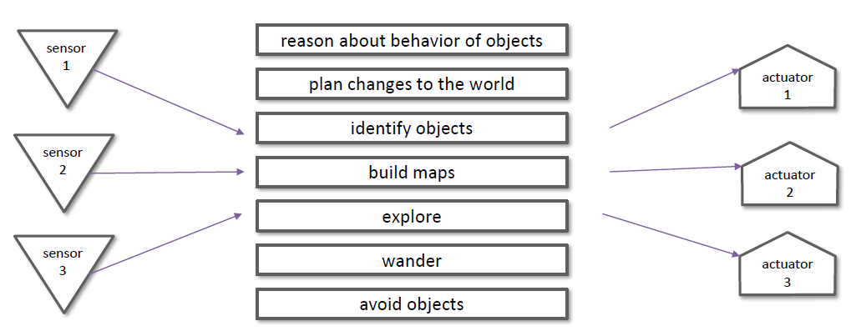
Robotics Modular Architecture Deliberative planner decomposed into features
Subsumption layers decomposed into features

Slide 97
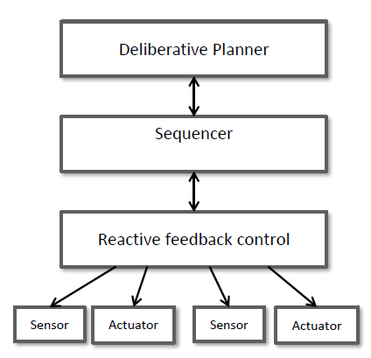
Robotics Modular Architecture Decompose system into three layers*
Why three layers? Different kinds of decisions
need to plan future
need to remember past
need sensors input
so, three layers:
Deliberative Planner: plans
Sequencer: saves past
Reactive control: stateless sensor/actuators
* https://citeseerx.ist.psu.edu/viewdoc/download?doi=10.1.1.43.9376&rep=rep1&type=pdf

Slide 98
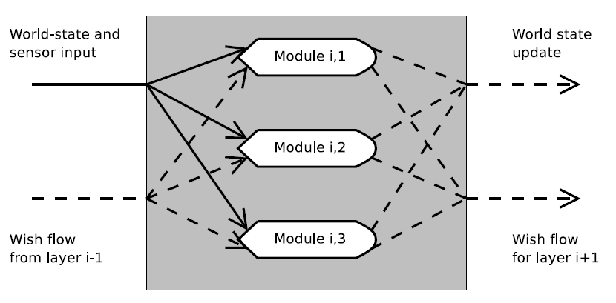
Robotics Modular Architecture
World state component
The world state component is a shared memory for the layers.
At the beginning of each turn the world state data are sent to Layer 1. The layer is able to
alter the world state by sending an abstract wish with the desired change to the world state component. The world state component then fulfills the abstract wish by updating the world state according to the wish. The world state data
are then sent to Layer 2, and so on.
A closer look at a subsumption layer showing the flow between modules inside layer-i.
Layer-1 does not receive any wish flow.

Slide 99
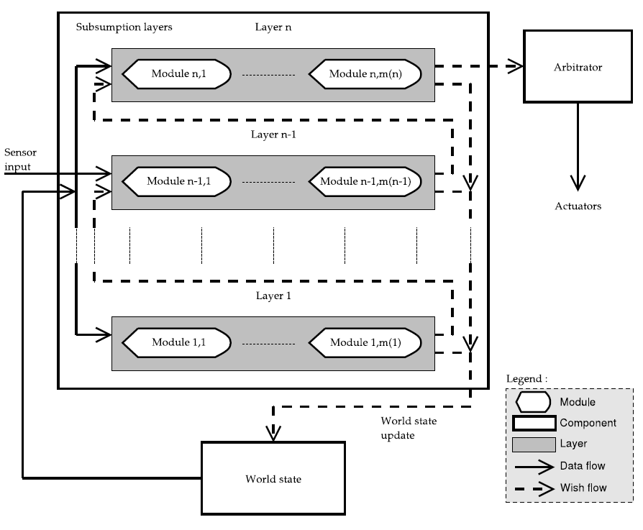
Robotics Modular Architecture
The hybrid architecture, shown in the Figure* is based on three components:
world state component, subsumption layers component and an arbitrator component.
The architecture has two types of flow: data flow and wish flow.
The data flow carries sensor input to the layers, data from the world state component to the layers and actions from the arbitrator to the actuators.
The wish-flow is a special kind of flow between each layer in the architecture, from the top layer to the arbitrator and from the layers to the world state component.
The layers create a wish list for the arbitrator to convert into actions. This wish list is carried by the wish flow.
* DAT3 REPORT Applying Machine Learning to Robocode Morten Gade Michael Knudsen Rasmus Aslak Kjær Thomas Christensen

Slide 100
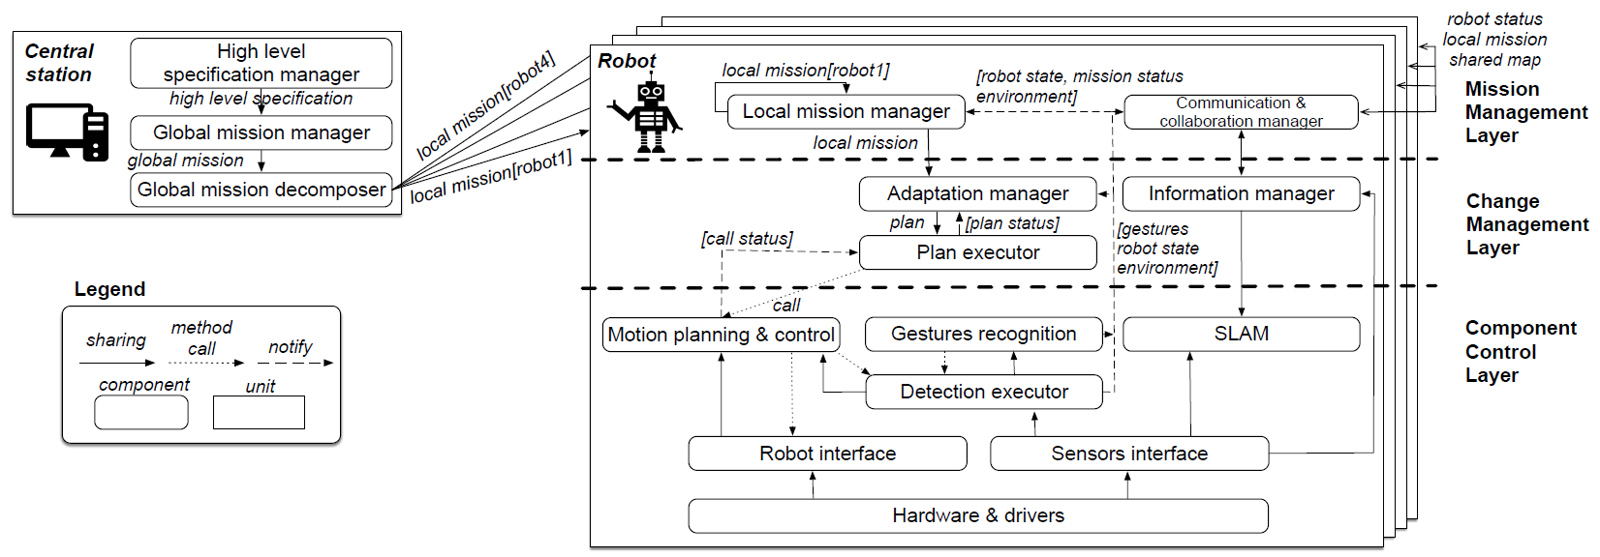
Robotics Modular Architecture Decentralized, Collaborative, and Autonomous Robots*
Instance of SERA architecture of 4 collaborating Robots, Central station, and 3-Layered architectures
Decoupled collaborating Robots
*http://www.cse.chalmers.se/~bergert/paper/2018-icsa-sera.pdf

Slide 101
Robotics Modular Architecture Decentralized, Collaborative, and Autonomous Robots
Central Station
Interprets high-level mission specifications, provides an interface to specify high-level missions
of the application in the component. The global mission to be achieved by the whole team in
a collaborative manner—checks the feasibility of the mission.
Mission Management Layer
Local mission specifications, incorporate real-time constraints, provided to each robot by means of timed temporal logic formulae. which is compliant with their dynamic behavior.
Component Control Layer
Provides the control actions required for the implementation of discrete paths that are generated by a high-level planner. It receives calls from the Plan executor and notifies the Adaptation manager about changes that are detected in the robot mission, or environment.

Slide 102
Feature-Orientation
Solve the problems:
Feature Traceability
Feature Separation
Collaboration & Roles
Feature Modularity
Feature-oriented programming is an approach for building software product lines that relies directly on the notion of features.
The idea is to decompose a system’s design and code into the features it provides. This way, the structure of a system aligns with its features, ideally, one module or component per feature.
To this end, new language constructs are needed to express which parts of a program contribute to which features and to encapsulate the feature’s code in composable, modular units.

Slide 103
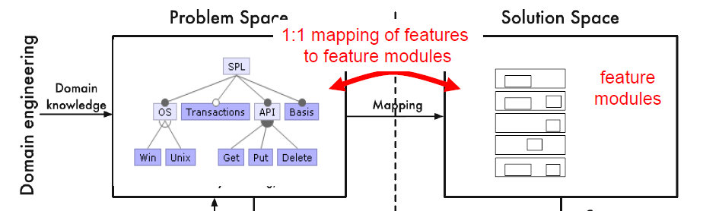
Feature-Orientation Feature Traceability
Feature traceability is the ability to trace a feature from the problem space (feature model) to the solution space, and vice versa (its manifestation in design and code artifacts).
The whole idea of feature-orientation and feature-based product derivation depends on establishing and managing the mapping between the problem and the solution space, in our case, between features and their implementation artifacts.

Slide 104
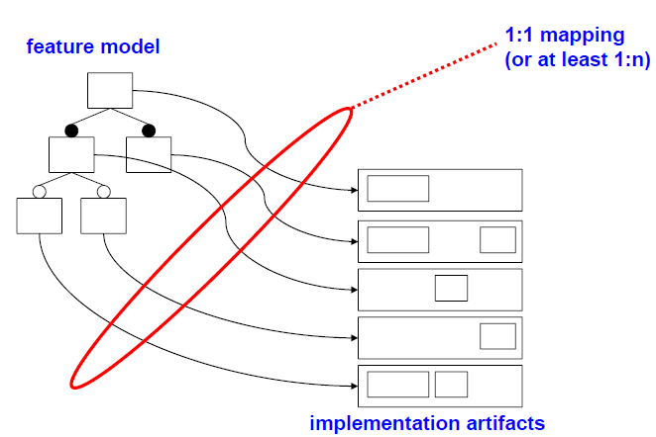
Feature-Orientation Feature Traceability
In SPL development, feature-oriented traceability is expected to map features to SPL designs and implementation elements, including commonalities and variations, to enable feature-oriented product derivation and evolution.

Slide 105
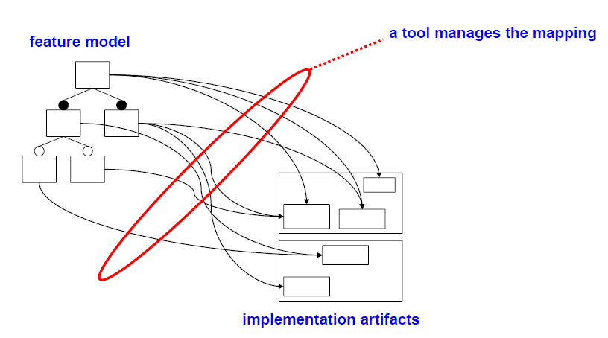
Feature-Orientation Feature implementability
Every product represented in the feature model can be implemented using the existing assets considering the implementability relation, which associates each feature in the scope with a set of core assets that are required for implementing the feature(s).
Optimize implementability aiming for high map coverage of features over artifacts.

Slide 106
Feature-Orientation Modularity of Feature-Oriented Programming
When decomposing a program into features, the individual parts are typically called feature modules.
The idea is to place everything related to a feature into a separate structure (file or folder), which is then called feature module.
Most concepts and tools in feature-oriented software development follow this notion of modularity, focusing on locality and cohesion.
In very large SPLs and features variations, 2^{f} , then modularity of features becomes so critical, especially in agile development environment.

Slide 107
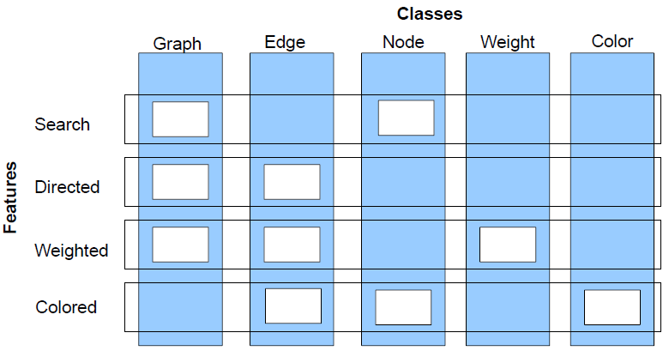
Feature-Orientation Separation of Classes
Features often realized by multiple classes, Classes often realized more than one feature, Keep class structure, but separate classes by features.

Slide 108

Feature-Orientation Class & Feature refinements*
Feature refinement — module that encapsulates the implementation of a feature.
A feature refinement encapsulates not an entire method or class, but rather fragments of methods and classes.
Figure 1 depicts three classes, c1—c3. Refinement r1 cross-cuts these classes, i.e., it encapsulates fragments of c1—c3. The same holds for refinements r2 and r3. Composing refinements r1—r3 yields a set of fully-formed classes c1—c3.
Feature refinements are often called layers
In general, feature refinements are modular, though unconventional, building blocks of programs.
*Generating Product-Lines of Product-Families Don Batory, Roberto E.,
Jean-Philippe Martin Department of Computer Sciences UTA.

Slide 109
Let’s Take a Break
Notes:
Just start with a question - want you to start thinking about this. (read)
This isn’t something with one answer, or even a right answer. It’s something we’ll keep returning to

Slide 110
Agile Practices and Industry Automation
Notes:
Just start with a question - want you to start thinking about this. (read)
This isn’t something with one answer, or even a right answer. It’s something we’ll keep returning to

Slide 111
Learning Objectives
Motivation
Introduce Agile Product Line Engineering APLE
Present APLE industry practices
Enabling APLE by automation tools

Slide 112
Agile Product Line Engineering APLE
The big upfront design associated with (Product Line Architecture)PLA conflicts with the current need of ‘‘being tolerant with change=Agile’’ *
To make the development of product-lines more flexible and adaptable to changes, many large companies are leaning to adopt APLE principles.
However, to put APLE into practice it is still necessary to introduce a suitable framework to assist and guide the agile practice and the evolve fully to APLE.
* Agile product-line architecting in practice: A case study in smart grids
Jessica Díaz ⇑, Jennifer Pérez, Juan Garbajosa, Technical University of Madrid-Universidad Politécnica de Madrid (UPM), E.U.

Slide 113

Agile Product Line Engineering APLE
The common concepts in Scrum are:
Scrum roles: “Product Owner”, “Scrum Master”, “Development Team”, and “Stakeholders”.
Scrum artefacts: “Product backlog”, “Sprint backlog”, “User Story” (US), “Task”, “Burn down charts”, “Impediment backlog” and “Definition of done”.
Scrum meetings: “Sprint planning 1”, “Sprint planning 2”, “Daily Scrum”, “Sprint review”, “Sprint retrospective”, and “Backlog refinement”.
Scrumban has been used to help teams and organizations accelerate their transitions to Scrum from other development methodologies.
Scrumban more responsive to change than Scrum,
Scrumban retains all the roles and meetings of Scrum.

Slide 114


Agile Product Line Engineering APLE
The graph* below shows that a waterfall model is much more sensitive against the requirements quality. The cost curve of waterfall model projects is growing exponentially – the later the defect is found, the more expensive it will be to fix it.
* Impact of Requirements Elicitation Processes on Success of Information System Development Projects Līga Bormane1 , Jūlija Gržibovska2 , Solvita Bērziša3

Slide 115
Agile Product Line Engineering APLE The AgiFPL FRAMEWORK*
AgiFPL is an agile methodology designed to improve the agility within the PLE and to meet effectively any newly emerged business expectations. Its main goal is to move teams from the classical approach to a more evolved APLE framework.
Using a goal-oriented requirement engineering approach (GORE), will provide the mechanism to easily evolve PL architectures in an agile context and will establish a suitable reuse strategy.
AgiFPL implement is an iterative process that uses Scrumban. GORE has been used for requirements engineering, business process reengineering, organizational impact analysis, and software process modeling.
* ”Agile Product Line Engineering: The AgiFPL Method” Hassan Haidar1, Manuel Kolp1 and Yves Wautelet2, 1LouRIM-CEMIS, Université Catholique de Louvain, Belgium, 2KULeuven, Faculty of Economics and Business, Belgium

Slide 116

The AgiFPL FRAMEWORK* Domain Engineering DE tier
The domain solution constitutes of “Domain requirement engineering” (DRE).
Start at “Software Vendor”
They develop business strategy
Which drive the DRE
The “Domain Design” (DD) is derived
FM & “Features Backlog” (FB) defined
Document F. into “User Stories” (US)
Define “Selected Backlog” (SB)
Planning-1 (What) is select next
“Development Team” structures user stories”Stories In Progress SIP Backlog”
Planning-2 starts (How)

Slide 117

The AgiFPL FRAMEWORK* Domain Engineering DE tier .
10- “Planning 2” meeting, the team
establishes the “Production Flow”
11- Daily Scrum: Done, Planned, Problems
12- Team” hold a “Review” meeting to
review the work accomplished.
13- Pass: “Common Assets Warehouse”.
14- Hold the “Retrospective” meeting
15- Incomplete Features pushed to SIP
16- SIP story can be pulled if it needs
only further testing.
A feature can consist of multiple USs

Slide 118


The AgiFPL FRAMEWORK Application Engineering AE tier
It includes several product lines where the outputs are client applications (products).
Starts at the “App Owner”. the“App i Requirement Engineering” (ARE i) phase
Two types of features coexist:
1. Features exist in “Common Assets Warehouse”. called “Selection of Features” (SoF).
2. Features that are to be developed called “Definition of Features” (DoF).
The DoF move to AE Solution domain for development.

Slide 119

The AgiFPL FRAMEWORK Application Engineering AE tier
The “Sprint” starts with the “Sprint Planning”. The team start “Sprint Planning” most important subset of “App backlog” items selected to the
next sprint.
At end of the “Sprint Planning”, the “Sprint Backlog” is defined and the “Definition of Done” (DoD) list is established.
In fact, DoD is a checklist of activities required to declare the implementation of a story to be completed.

Slide 120
Agile Product-Line Architecting (APLA)
APLA is the integration of a set of models for describing, documenting, and tracing Product Line Architectures PLAs*, as well as an algorithm for guiding the change decision-making process of PLAs.
The APLE development process requires that PL-architectures
are incrementally and iteratively designed, and
welcome unplanned changes. The PL-architecture has to evolve in each of the iterations to incrementally include all the features of the product-line.
* Agile product-line architecting in practice: A case study in smart grids
Jessica Díaz ⇑, Jennifer Pérez, Juan Garbajosa, Technical University of Madrid-Universidad Politécnica de Madrid (UPM), E.U.

Slide 121
Agile Product-Line Architecting (APLA)
The objectives of APLA:
Provide software architecture with flexibility and adaptability when defining software architectures to facilitate change during the incremental and iterative design of PLAs as well as their evolution (unanticipated change).
Facilitate architectural concerns, such as dependencies, rationale, constraints, or risks, that may be impacted by change.
Provide guidance in the decision-making process during constructing and evolving PLAs to facilitate change impact analysis in terms of architectural components and connections that may be impacted by change.

Slide 122
Agile Product-Line Architecting (APLA)
To achieve these objective, we need first to define some terms:
Plastic Partial Component PPC address agile architecting by defining architectural components in an iterative and incremental way.
The variability of a PPC is specified using variability points, which hook fragments of code to the PPC known as variants, and weavings which specify where and when to extend the PPCs using the variants.
Weavings are defined outside from PPCs and variants, so that these PPCs and variants are independent of the weaving or linking context.
As a result, PPCs reduce dependences and coupling between components and their variants, while enable easy and cheap (un-)weaving of variants.

Slide 123

Agile Product-Line Architecting (APLA)
The graphical representation of a PPC that defines a variability point and n variants.
Variability points behave as extension points and variants behave as extensions.
Namely, the PPC variability mechanism behaves as an extension mechanism to flexibly compose pieces of software, as if we were building a puzzle.
Since they are unaware of the linking context they can be easily changed, without coupling concerns.
Definition of variability: PPC extension mechanism.
Documentation of design decisions

Slide 124

Agile Product-Line Architecting (APLA)
The PLAK Metamodel and its modeling primitives have been reused to capture the knowledge of adding feature increments or changing features in each agile iteration.

Slide 125
Agile Development and Product Line Engineering at LM
In late 2014, corporate management decided that Agile was the way to strengthen Lockheed Martin’s competitive position on its large legacy product line program.
At LM the agile challenge is serious:
The products –are large by any standard, comprising some 10 million lines of code and costing tens to hundreds of millions of dollars.
The teams, spread across the products, are sizable. The largest component, for example, involves over 200 engineers. Some 800 engineers are involved in the product line.
The build cycles, under the product line’s are four months long.
* IBM® Engineering Requirements Management DOORS® (DOORS) is requirements management tool to capture, trace, analyze, and manage changes.

Slide 126

PLEs Industry case General Motors PLE’s automated support
GM deals with mega-scale product lines and
keeping track of the variation in each system
and the feature interactions among systems
leads to too many possible systems variations.
GM needed a tool to manage variation points
in their engineering artifacts and help configure
vehicle-specific engineering products. For this,
they chose Gears from BigLever Software.

Slide 127


PLEs Industry case General Motors PLE’s automated support
A “superset” supply chain of reusable digital assets is used, with variation points (illustrated by the small gear symbols) defined in terms of features
in the product line’s Feature Catalog.
The features chosen for each product are specified in the Bill-of-Features for that product.
The Gears product configurator creates a product instance by exercising variation points according to the features selected.
PLEfactory, based on Gears

Slide 128
PLEs Industry case General Motors PLE’s automated support
The bill-of materials for a vehicle’s electronics is generated from its bill-of features.
To capture features, here is the set of feature modeling constructs (provided by Gears) that GM is using for its product line work:
Feature declarations are parameters that express the diversity in the product line for a system or subsystem.
Feature profiles are used to select and assign values to the feature declaration parameters for the purpose of instantiating a product.
Assets are the abstraction for systems and software artifacts in a production line.
Variation points encapsulate the variations in the assets used to build products.

Slide 129

PLEs Industry case General Motors PLE’s automated support
Assets are built and maintained on the
left; each is endowed with one or more
variation points (indicated by the gear
symbol).
Feature profiles determine how the
assets are instantiated (by exercising
their variation points) to produce
product-ready artifacts.

Slide 130

PLEs Industry case General Motors PLE’s automated support GEARS interface,
GEARS platform supports plug-ins, for example,
DOORS requirements modules, Microsoft Word documents and Excel spreadsheets, and UML, and many more.
Gears supports various artifacts maintained under the proprietary of various tools. In that figure, a bridge is a piece of software that “knows” the other-tool representation and presents a “product-line-aware” user interface for that tool that allows product line engineers to insert variation points in the artifacts maintained by that tool.

Slide 131

PLEs Industry case General Motors PLE’s automated support GEARS Roles at GM
The Figure sketches the major PLE roles and their broad responsibilities vis-à-vis maintaining the PLE models and artifacts.
PRODUCT LINE INTEGRATION ENGINEER
This engineer collaborates with Vehicle Product Teams in the selection of a ‘bill-of-features’ for a vehicle being planned.
The product line integration engineer also collaborates with the feature owners in the identification of the top-level subsystem production line ‘products’ that will be offered up to vehicles.

Slide 132
Feature-Based Testing
Notes:
Just start with a question - want you to start thinking about this. (read)
This isn’t something with one answer, or even a right answer. It’s something we’ll keep returning to

Slide 133
Testing Stages
API
GUI
CLI
We interact with systems through interfaces.
Systems built from subsystems.
With their own interfaces.
Subsystems built from units.
Classes work with other classes through methods (interfaces).
API
API
Notes:
We can break testing into independent stages that we stagger throughout the development process. These stages are largely built around different levels of granularity within the system under test. If we look at the system from the outside, it looks like this box. It has interfaces - maybe a GUI, maybe an API, maybe some kind of command line interface. However, there is also a lot going on inside. (click). The system as a whole tends to be architected, as we saw, as a set of larger indepedendent subsystems. Each of these has their own interface, and the subsystems communicate with each other through those interfaces. (click) then, within those, we have a bunch of individual, standalone UNITS (classes), all working together to produce the functionality offered by that subsystem, by calling methods in the other classes when needed - with methods forming another kind of interface. We need to test at all of these levels - class (or unit), subsystems, and the system as a whole.

Slide 134
Testing Stages
API
GUI
CLI
Unit Testing
Do the methods of a class work?
System Testing
Subsystem Integration Testing
Do the collected units work?
System Integration Testing
Do the collected subsystems work?
UI Testing
Does interaction through UIs work?
API
API
Notes:
Broadly, then, when we talk about testing, we talk about either unit testing or system-level testing, with a couple of distinct types of testing in there. (1) is where we tend to spend most of our testing time - we take small pieces of the system - units - the smallest chunk of system we can work with. Generally one class or a small cluster of classes. And we test those in isolation from the rest of the system. We take a class, and come up with tests for each of its methods. We try to isolate these units as much as possible - even faking the results passed from pieces of the system that we aren’t currently testing. Then we move up the ladder to what we collectively call system testing, which encomapsses three things. (click) Subsystem Integration Testing: We bring these units together - which have now been tested independently and we test their integration with each other - can they work together without breaking everything. Even if we’ve tested the individual units, faults can emerge from their combination, so we integrate the units together and test their combination and whether the subsystem as a whole can perform the functions that we stated in the specification. (click) Then we can test the system as a whole, through its high-level interfaces, to test the integration of the combined system to ensure that therre aren’t integration errors and that the product as a whole meets the requirements. This is System Integration Testing. (click) The third element of system testing is what we call UI testing - where we test from the direct perspective of a user, generally through a GUI. System Integration Testing and UI testing tend to have a blurry line between them, and more come down to whether tests are executed through a GUI or a program-level interface like a REST API or through the command line.

Slide 135
Creating System-Level Tests
Identify Independently Testable Functionality
Identify functionality that can be tested in (relative) isolation.
Identify Choices
Identify the choices you control when testing.
Identify Representative Input Values
Identify values for each choice that lead to different function outcomes.
Generate Test Case Specifications
Identify abstract test cases based on choice combinations.
Generate Test Cases
Identify concrete input/expected output pairs.
Notes:
Creating System-level tests is a five stage process.
You need to figure out what the independently testable functionality of your system or subsystem is. What features or functions are surfaced by an interface and can be tested in isolation. What can we push and observe in the software?
For each of those features, what varies? What can you control when you test? This includes both the actual input parameters - what you can pass to the functionality - and any other choices you can make. In a SPL, this includes the set of features you choose from that affect this functionality, and those choices in turn affect other choices.
For each of those features, what are the possible outcomes - each possible normal outcome or error outcome - and for each choice, what kind of input will trigger each possible outcome.
This leads you to abstract test case types, based on the combinations of choices we can make
Then, instantiate the specifications by providing concrete input instead of abstract choices to produce individual test cases with exact input and expected output pairings.

Slide 136

Test Specifications
May end up with thousands of test specifications.
Which do you turn into concrete test cases?
Filter impossible or redundant combinations of values.
Try to capture all (2-way, 3-way, N-way) feature interactions.
Notes:
Now, this process leaves you with all of these test specifications, abstract descriptions of test cases you could create. Each of those can lead to hundreds of concrete test cases. This is for ONE high-level function of your software. You clearly can’t try every one of those specifations. Which are important, then? Which should you take and instantiate as concrete system level test cases? This is something we will explore today. In short, (last two)

Slide 137
Category-Partition Method
Generates test specifications from requirements.
Choices, representative values, and constraints.
Choices: What you can control when testing.
Representative Values: Logical options for each choice.
Constraints: Limit certain combinations of values.
Generate a list of test specifications to cover.
Apply more constraints to further limit set.
Notes:
(title) is A method of generating test specifications from requirement specifications that simply adds a small number of additional steps on the process discussed last class.
For an independently testable function, you identify (2). Choices and representative values are things we covered last time. Choices are what you control when testing - the types of values you can feed a parameter, the variants you choose at variation points in your feature model, and additional environmental factors that can influence the outcome of the function. Then, you identify representative values for each choice. Divide the input space up into logical partitions based on the outcomes they can trigger in the function. The new element here are the constraints. Three types of constraints - called if-constraints, error constraints, and single constraints, are used to control the number of test case specifications that you need to create concrete test cases for. once you have these categories, choices, and constraints, you can use them to estimate the number of test cases that you’ll need to generate, and (last point). This lets you determine the number of cases that you’ll need to create before spending human effort creating them. That’s a powerful concept - if you end up with too many test cases that need to be formed, you can apply more constraints until you get a reasonably sized test suite. This is obviously a better apporach than building a bunch of tests and then realizing that you’re out of time

Slide 138
Constraints Between Values
IF-CONSTRAINT
This value only needs to be used under certain conditions (if X is true, use value Y)
ERROR
Value causes error regardless of values of other choices.
SINGLE
Only a single test with this value is needed.
Corner cases that should give “good” outcome.
Notes:
There are three types of constraints that we can define to reduce the number of pairings.
-(1-2) for instance, you might choose a value for one choice only if a particular value is used for another choice.
-(3-4) so we don’t need every combination of values for all choices that include this particular value Just one test with this error-inducing value should be enough for us.
- (5-6) Single is similar to error, but more general purpose. A value is special or unusual in some way, but should still give us a “good” normal outcome. So we want totry it once just to be sure. However, we don’t need every combination of other values for other choices with this one value for this one choice. We just need one test that uses this particular value and we can move on.

Slide 139
Example - Substring
substr(string str, int index)
Choice: Str length Choice: index
length = 0 value < 0
length = 1 value = 0
length >= 2 value = 1
Choice: Str contents value > 1
contains letters and numbers
contains special characters
empty
property zeroLen, TRUE if length = 0
ERROR
if !zeroLen
if !zeroLen
SINGLE
if zeroLen
Notes:
Let’s take a simple example, a substr function. Takes in a string and an index and returns everything from the start of the string to that index. For each choice, we have some representative values (go over)
What are some of the constraints we can try applying? (discuss)
(click)- prop/if read
(click)- error
(click)- single - this one shouldn’t result in an error, but werid things could happen. We only really need to try it out once. It should execute and work,. So, let’s try it once

Slide 140
Limiting Num. of Test Specifications
Bandwidth Mode | Language | Fonts
Desktop Site | English | Standard
Mobile Site | French | Open-Source
Text Only | German | Minimal
 | Swedish
Advertising | Screen Size
No Advertising | Phone
Targeted Advertising | Tablet
General Advertising | Full Size
Minimal Advertising
Full set = 432 specifications
No natural IF, SINGLE, ERROR constraints for these features.
What is important to cover?
Notes:
However you get value classes for each choice, the next step in producing test case specifications is selecting combinations of values for those choices. A simple approach is to exhaustively enumerate all possible combinations of values, but as we saw the number of possible combinations explodes. Some methods, like the category-partition method, take exhaustive enumeration as a base approach to generating combinations, but allow the test designer to add constraints that limit growth in the number of combinations. This can be a reasonable approach when the constraints come naturally from the application domain, and eliminate many redundant combinations (like the “error” entries in the category-partition testing examples). It doesn’t work if you lack real constraints from the application domain,and the test designer is forced to add arbitrary constraints whose sole purpose is to reduce the number of combinations. How do you know you got it right? Consider the set of features that control the appearance of our web site, shown here on this slide. Exhaustive enumeration produces 432 combinations, which is too many for one feature. WE could hypothesize some constraints, such as observing that monochrome displays are limited mostly to hand-held devices, but radical reductions require adding several “single” and “property” constraints without any particular rationale. This is where category partition method can break down and why it is more of a starting point then the end point. So, what can we do with this?

Slide 141
Combinatorial Interaction Testing
Cover all k-way interactions (k < N).
Typically 2-way (pairwise) or 3-way.
Set of all combinations grows exponentially.
Set of pairwise combinations grows logarithmically.
(last slide) 432 combinations.
Possible to cover all pairs in 16 tests.
Notes:
When it is reasonable to expect some potential interaction between features, but covering all combinations is impractical, a reasonable alternative is to cover all k-way combinations for k < n, up to the limit of what we want to examine - typically pairs or triples (2-way or 3-way) feature interactions. How much does generating possible pairs of values save, compared to coming up with all combinations? We have already observed that the number of all combinations is the product of the number of values for each choice, and that this product grows exponentially with the number of choices. It turns out that the number of combinations needed to cover all possible pairs of values grows only logarithmically with the number of choices — an enormous savings in effort. (last two points)

Slide 142
Example - Website Display
Language | Advertising
English | No Advertising
English | Targeted Advertising
English | General Advertising
English | Minimal Advertising
French | No Advertising
French | Targeted Advertising
French | General Advertising
French | Minimal Advertising
German | No Advertising
German | Targeted Advertising
German | General Advertising
German | Minimal Advertising
Swedish | No Advertising
Swedish | Targeted Advertising
Swedish | General Advertising
Swedish | Minimal Advertising
Bandwidth Mode
Desktop Site
Mobile Site
Text Only
-
-
Desktop Site
Mobile Site
Text Only
Text Only
-
Desktop Site
Mobile Site
Mobile Site
Text Only
-
Desktop Site
Fonts
Standard
Open-Source
Minimal
Minimal
-
Minimal
Standard
Open-Source
Minimal
-
Open-Source
Standard
Open-Source
Standard
-
Minimal
Screen Size
Phone
Tablet
Full Size
Phone
-
Full Size
Tablet
Phone
Tablet
-
Phone
Full Size
Full Size
Phone
-
Tablet
Bandwidth Mode | Language | Fonts
Desktop Site | English | Standard
Mobile Site | French | Open-Source
Text Only | German | Minimal
 | Swedish
Advertising | Screen Size
No Advertising | Phone
Targeted Advertising | Tablet
General Advertising | Full Size
Minimal Advertising
Mobile Site
Notes:
Five choices. Two with four options, and three with three = 432 combinations, but we can do it in less. Again, start with two variables. Start with the ones with the most options. In this case, we have two with four choices (click) So, 16 combinations (4x4). (go over) Now, we want to add a third. The rest all have three values, so add any of those. We will add bandwidth mode (click) Here, we want to again try to match all combinations with the previous two. (go over). Now, there are fewer values for this variable, so you’ll notice some dashes. These are cases where we don’t really care what value we pick. We might need to fill in some of these later on, but for now, they could be any combination. (click) Now, we bring in the fourth, fonts. (click) Now, here we need to go back and fill in a “don’t care” for bandwidth mode to get a “mobile” interaction with minimal. Finally, we add that fifth, screen size (click) Here, we don’t need to set any more don’t care values to get all combinations in. So, we can do this in 16 tests. Way better than 432! We might still miss issues with higher-order feature interactions, but all 2-way interactions - which are the most common source of problems - will be caught this way.

Slide 143
Automated Test Generation
Notes:
Just start with a question - want you to start thinking about this. (read)
This isn’t something with one answer, or even a right answer. It’s something we’ll keep returning to

Slide 144

Automating Test Creation
Testing is invaluable, but expensive.
We test for *many* purposes.
Near-infinite number of possible tests we could try.
Hard to achieve meaningful volume.
Relieve cost by automating test input generation.
Notes:
We must produce reliable, robust software. Testing is invaluable in that quest. The downside, of course, is that testing is also very expensive especially since we test for *many* purposes, validating correctness, assessing performance, looking for security vulnerabilities, memory leaks, excessive battery usage, and so on. Any real-world piece of software with value has (3-5).

Slide 145
Test Creation as a Search Problem
Do you have a goal in mind when testing?
Make the program crash, achieve code coverage, cover all 2-way interactions, …
You are searching for a test suite that achieves that goal.
Algorithm samples possible test input to find those tests.
Notes:
Let’s reformulate how we think of testing a little. The common thread is that we have a purpose in testing, some kind of goal in mind (2, whatever we want to do when we create tests)
(3) Out of the massive space of input, we want any one that gives us what we are searching for. The smallest covering array of 2-way interactions, tests that achieve 100% statement coverage, tests that detect a set of seeded faults, etc.
Is that goal measurable? Then we’re in good shape. If you have a goal, and if that - if we can judge whether or not we’ve achieved that goal, then you have a search problem. Out of the near-infinite set of inputs, I would like a set of inputs that meets that goal. Then, we can have an algorithm sample test inputs from the space of all possible input in an attempt to optimize that goals.

Slide 146
Test Creation as a Search Problem
“I want to find all faults” cannot be measured.
However, a lot of testing goals can be.
Check whether properties satisfied (boolean)
Measure code coverage (%)
Count the number of crashes or exceptions thrown (#)
If goal can be measured, search can be automated.
Notes:
The ultimate goal of testing, to find all faults, is not something we can check for attainment of. We don’t know what faults exist. WE can’t know what faults exist. However ,we’ve invented all of these practices and measurements as approximations of the idea of fault-finding effectiveness - if you do these things, you will probably find faults - and the vast majority of those can be measured in one of three ways. Many in yes/no checks (3), others we can even watch the progress of and check partial completeness (4). Yet others we can count and say that higher counts are better, even if we don’t know the ceiling (5) As it turns out, computers are very good at these kind of search problems. If we can take a candidate solution and check whether it meets our goal, then computers can search for a solution, and there are many techniques we can use.

Slide 147

Search-Based Test Generation
Make one or more guesses.
Generate one or more individual test cases or full suites.
Check whether goal is met.
Score each guess.
Try until time runs out.
Alter the population based on search strategy and try again!
Notes:
The rough idea of a search process is that you (1-2). (3) Score each solution based on their attainment of the overall goals. Then (5) Alter the population of guesses based on our search stragegy- our heuristic and potentially feedback from those scores - and try again.

Slide 148



Search-Based Test Generation
+
=
The Metaheuristic
(Sampling Strategy)
Genetic Algorithm
Simulated Annealing
Hill Climber
(...)
The Fitness Functions
(Feedback Strategies)
Distance to Coverage Goals
Count of Executions Thrown
Input or Output Diversity
(...)
(Goals)
Cause Crashes
Cover Code Structure, Generate Covering Array,
(...)
Notes:
Here is our equation for success. Testing has one of more goals, such as executing certain code elelements, driving the system to throw exceptions, detecting planted faults. This process, then, should yield test suites that satisfy these goals. The metaheuristic- the algorithm - and the fitness functions combine to yield these tests. The algorithm is responsible for population evolution, as guided by the fitness functions. The fitness functions offers a strategies that shape the test suites, ideally in a way that brings us closer to our goal. The metaheutistic formulates solutions, then uses the fitness scores to decide which solutions to promote and how to reformulate the population - propagating good solutions forward, creating minor variants - mutants -based on those solutions, combining elements of good solutions - crossover - to form new solutions, and generating some more random guesses. It then scores those using the fitness functions, and reformualtes again until time runs out.These are the three pieces of the equation that we can manipulate - algorithm, strategies, and goals. This process is used in fuzzing daily by companies like Google, Facebook, and Microsoft to identify bugs and security vulnerabilities in the products you use every day.

Slide 149
Wrap-Up
Thank you for making this a great course!
Any remaining questions?

